Slide 1
Basics of Programming in C
S.Hemalatha
Assistant Professor(Sr.G)
MCA
KEC

Slide 2
Datatype:
Programming language: to interact with machine by the human being(medium of communication between the machine and the human being).
Machine – can understand the language which is in the form of 0’s and 1’s(native language- binary language).
Set of indtructions which should be in the form of 0 and 1.
0000111100011000110101010100
0001000111000110001
Assembly language: (assembler – to convert/translate the assembly code to machine code(binary))
ADD a,6
STORE c,a
MOVE
High level language : (completely userfriendly to the programmer) c, c++, java, c#,python
Engligh language-like instructions: if, else
Machine cannot understand assembly or high level
Compiler/intrepreter – converting from high level code to machine code
translator/intermediator:

Slide 3
Sum of two numbers: (value type)
Input (10,20) (number)
Process(10+20)
Output(30)
Hemalatha(i/p) (string)
Hemalatha(o/p)
500.75(i/p) (number with decimal point)
500.75(o/p)
A (character)
B
C

Slide 4
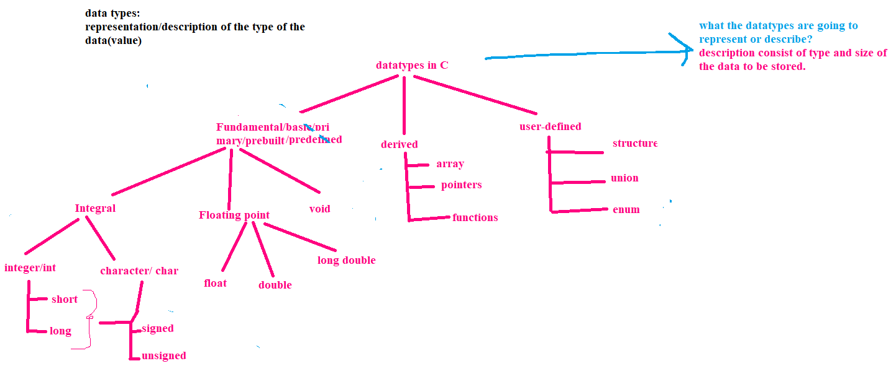
Data types
What type of modifier is needed To store both positive and negative?
Negative –signed
Only positive – unsigned
short int and long int
Signed short int and unsigned short int
Signed long int and unsigned long int
Signed char and unsigned char

Slide 5
void Type and Modifiers
void Type:
Used in 3 kinds of situations:
As function argument and return type of a function
As Pointers (generic pointer)
Modifiers:
To modify the default properties of basic datatypes.
Prefixed with basic datatypes to modify(either to increase or decrease ) the amount of storage space allocated to a variable.
Modifiers are:
Short (to store small numbers)
Long (to store very large numbers)
Signed :
It is default modifier of int and char data type if no modifier is specified. It says that user can store negative and positive values.
Unsigned:
When user intends to store only positive values in the given data type (int and char).
Long long

Slide 6
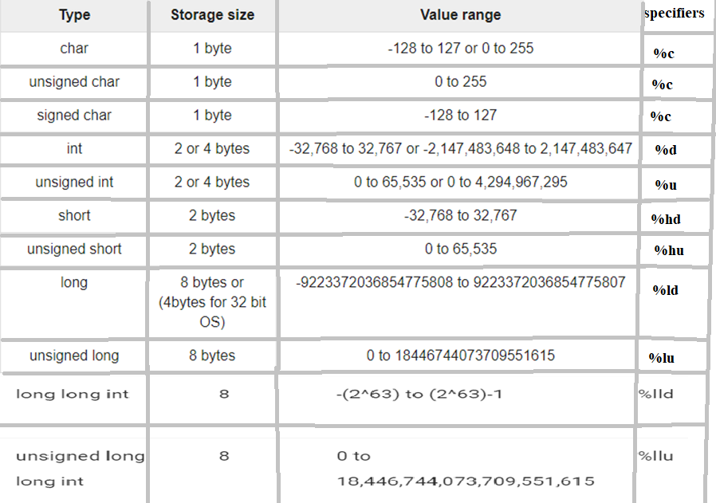
Data types
char
signed int/

Slide 7
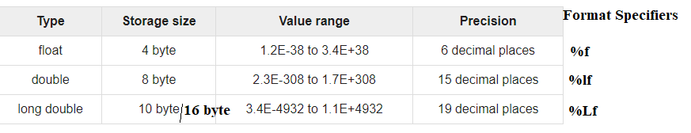
Floating Point (always signed) : fractional and Exponential form
Based on the compiler the size may get varied
10
10.345533
Signed: able to hold both positive and negative values
Unsigned : never be negative.
Characters are stored as per their ASCII values.(American Standard Code for Information Interchange) eg ‘A’ equivalent decimal is 65
‘a’ ‘v’ ‘g’ ‘t’ ‘1’ ‘5’ ’65’ - character constants/literals
“hai” – string literal or constant
Datatype varname=value;
char ch=‘A’;
Eg
signed char ch1=255; (-128 to 127)
unsigned char ch2=255; (0 to 255)
printf(“%d%d”, ch1,ch2);
Output : -1,255
Exponential / scientific form:
0.000342 => 3.42e-4
7500000000 => 7.5e9 or 75E8

Slide 8
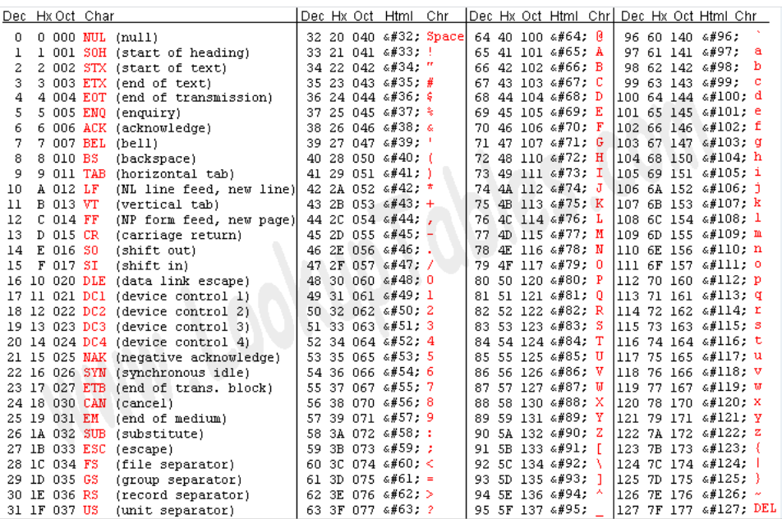
ASCII table

Slide 9
First Simple program
#include <stdio.h>
int main() //definition for main function
{
// Displays the string inside quotations (comment line)
printf("C Programming"); //function call for printf()
return 0;
}
All valid C programs must contain the main() function. The code execution begins from the start of the main() function.
The printf() is a library function to send formatted output to the screen. The function prints the string inside quotations.
To use printf() in our program, we need to include stdio.h header file using the #include <stdio.h> statement.
The return 0; statement inside the main() function is the "Exit status" of the program. It's optional.

Slide 10
Can we use the printf() function without using a <stdio.h> header file in C programming?
Yes, it is possible, but why deliberately shoot yourself in the foot?
When we use the printf function, we include stdio.h to get the function’s official prototype, the same prototype that was used by the author of the printf function that’s in your standard library. By providing that prototype to the compiler when you compile your code, the compiler can check to make sure that the first argument you pass to printf is a pointer to a char (a pointer to the format string). Without the prototype available, the compiler can’t perform any type checking on the arguments.
When the function prototype is not present for a function you’re calling, most decent compilers will warn you that the compiler has no idea how the function should be called, and makes the assumption that the function returns an int. In the case of printf, this assumption is correct, but there are many cases where this assumption is dead wrong.
To get rid of the warning, you could type in the function prototype yourself, but this is extra work and you run the risk of writing a prototype that doesn’t exactly match the correct prototype that appears in the header file. When that happens, weird things can happen, collectively referred to as undefined behavior. If your function prototype doesn’t specify the correct type and number of parameters, or doesn’t specify the correct return type, you’re going to run into trouble.
Consider what happens when using one of the math functions without including math.h, and without supplying any function prototypes for them yourself. Many of these functions return double, but without a function prototype (i.e., without including the math.h header file), the compiler will incorrectly assume the functions return int, and will generate incorrect code. If you don’t include the header file and you ignore the warning from the compiler, you will get incorrect results.
Whenever you force the compiler to make an assumption, you are gambling that it made the correct assumption. Its assumptions are often wrong. Gambling and programming should not be mixed.
Get into the habit of including the header files you need. They are there to help the compiler generate correct code, and to help you use the functions properly. And don’t ignore compiler warnings…they are your friends.
https://medium.com/@luischaparroc/https-medium-com-luischaparroc-dynamic-libraries-in-c-96a989848476

Slide 11
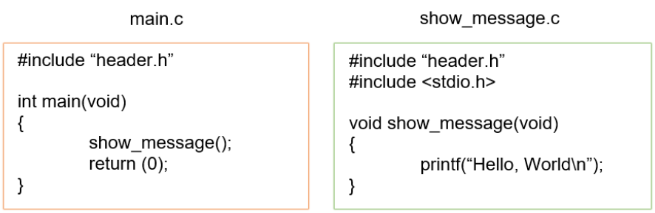
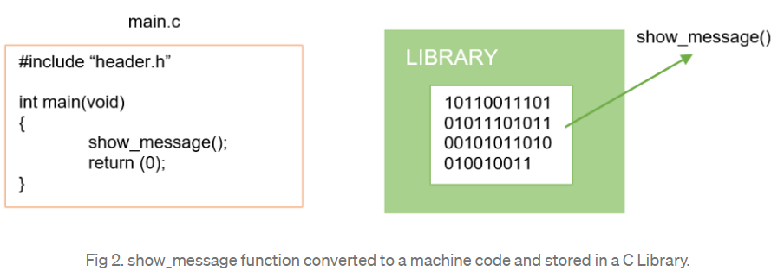
Then, show_message is pre-compiled (converted to machine code) and stored in a library:

Slide 12
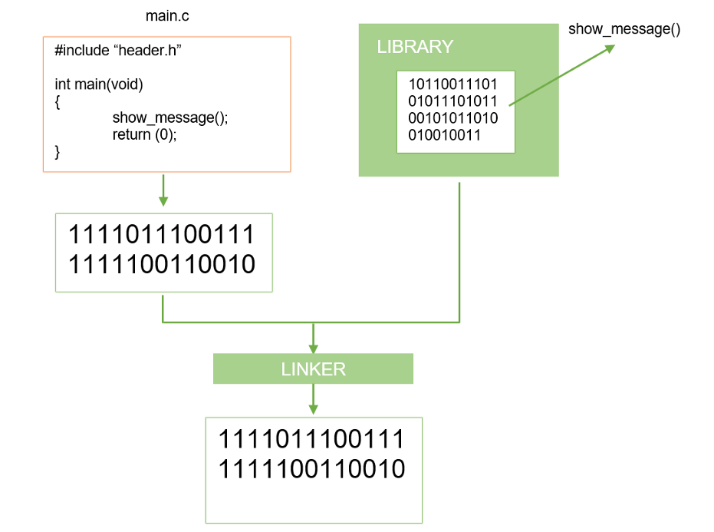
The Entry Point is compiled too. show_message is joined to the source code through linker. But unlike the static library, the machine code of show_message is not added to the executable file:

Slide 13
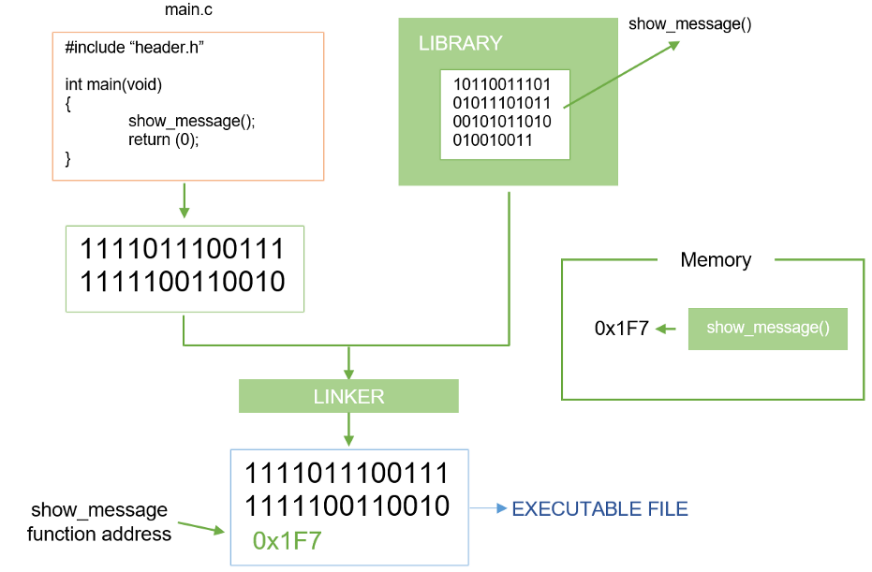
Instead, the library is loaded in the memory and the address of the function called is added into the executable file:

Slide 14
According to the previous process, the Entry Point is compiled when it only needs to be updated. Likewise, the functions of the library are pre-compiled again when they change, without re-compile the main function. The updated library would be loaded in the memory.
In Unix, dynamic libraries are called shared libraries.

Slide 15
printf() function
The printf() function is used for output. It prints the given statement to the console.
Syntax/General Form:
printf("format string",argument_list);
The format string can be %d (integer), %c (character), %s (string), %f (float) etc.
It returns total number of Characters Printed, Or negative value if an output error or an encoding error.
#include <stdio.h>
int main() {
int testInteger = 5; // intialization or assigning initial value to the variable
printf(“welcome”);
printf("Number = %d", testInteger); %d(5) printf(“Number=5”);
Printf(“%d”,testInteger); // 5
return 0;
}
Output
Number = 5
We use %d format specifier to print int types. Here, the %d inside the quotations will be replaced by the value of testInteger.
testInteger/1000-1003
5

Slide 16
#include <stdio.h>
int main() {
float number1 = 13.5; // what type of literal is 13.5?
double number2 = 12.4;
printf("number1 = %f\n", number1);
printf("number2 = %lf", number2);
return 0;
}
Output
number1 = 13.500000
number2 = 12.400000
To print float, we use %f format specifier. Similarly, we use %lf to print double values.
Example 4: Print Characters
#include <stdio.h>
int main() {
char chr = 'a';
printf("character = %c", chr); // printf("character = %d", chr); //97
return 0;
}
Output
character = a

Slide 17
printf() function
int main()
{
char st[] = "CODING";
printf("While printing ");
printf(", the value returned by printf() is : %d", printf("%s", st));
return 0;
}
Output :
While printing CODING, the value returned by printf() is : 6
#include <stdio.h>
int main()
{
long int n = 123456789;
printf("While printing ");
printf(", the value returned by printf() is : %d", printf("%ld", n));
return 0;
}
Output
While printing 123456789, the value returned by printf() is : 9

Slide 18
scanf()
scanf() : scanf() is one of the commonly used function to take input from the user. The scanf() function reads formatted input from the standard input such as keyboards(console).
It returns total number of Inputs Scanned successfully, or EOF if input failure occurs before the first receiving argument was assigned
Syntax:
scanf("format string",&argument_list);
Eg
int number;
scanf("%d",&number); //getting values dynamically for the variable “number” (assigned during execution of the program)
int number=10; //static assignment (assigned at compile time)
int a=10,b=20;
int number=a+b; //dynamic initialization of variable;
x
all function arguments in C are passed by value. If you call a function, for example func(n), the function receives a copy of the value of n. It has no access to the real memory of n itself.
If you want the function to be able to modify n, you have to pass its address.
The scanf function needs to modify the values of variables, so you need to use &n rather than just n to let it do that. (It can’t just return the value as its result, because it can update multiple variables in a single call)

Slide 19
#include <stdio.h>
int main() {
int testInteger;
printf("Enter an integer: ");
scanf("%d", &testInteger);
printf("Number = %d",testInteger);
return 0;
}
Output
Enter an integer: 4
Number = 4
Here, we have used %d format specifier inside the scanf() function to take int input from the user. When the user enters an integer, it is stored in the testInteger variable.
Notice, that we have used &testInteger inside scanf(). It is because &testInteger gets the address of testInteger, and the value entered by the user is stored in that address.

Slide 20
int main()
{
char a[100], b[100], c[100];
// scanf() with one input
printf("\n First scanf() returns : %d“, scanf("%s", a));
// scanf() with two inputs
printf("\n Second scanf() returns : %d“, scanf("%s%s", a, b));
// scanf() with three inputs
printf("\n Third scanf() returns : %d", scanf("%s%s%s", a, b, c));
return 0;
}
Input: Hey!
welcome to
geeks for geeks
Output:
First scanf() returns : 1
Second scanf() returns : 2
Third scanf() returns : 3

Slide 21
Variables
A variable is a named location in memory that is used to hold a value that can be modified by the program. All variables must be declared before they can be used.
The general form / syntax of a declaration of variable is
datatype variable_list;
- datatype must be a valid data type plus any modifiers,
- variable_list may consist of one or more identifier names separated by commas.
Here are some example declarations:
int i, j, l;
short int si;
unsigned int ui;
double balance, profit, loss;

Slide 22
Where Variables Are Declared?
Variables can be declared in three places:
inside functions/block (local varaibles)
in the definition of function parameters (formal Parameters/local to that function)
outside of all functions/block(global varaibles)

Slide 23
Local Variables
Variables that are declared inside a function/ block are called local variables. In some C literature, these variables are referred to as automatic variables (auto).
Local variables can be used only by statements that are inside the block in which the variables are declared.
local variables are not known outside their own block.
A block of code begins with an opening curly brace and terminates with a closing curly brace.

Slide 24
Local variables
Local variables exist only while the block of code in which they are declared is executing.
That is, a local variable is created upon entry into its block and destroyed upon exit.
A variable declared within one code block has no relationship to another variable with the same name declared within a different code block.
the keyword auto, which you can use to declare local variables

Slide 25
block or code block
A block is a section or portion of software code in software programming.
A block can consist of one or more statements or declarations. It is possible for a block to contain one or more blocks nested within it.
Blocks are a basic feature of structured programming and help to form control structures.
At the same time, blocks can improve code efficiency.
The beginning of the block is denoted by an open curly brace '{' and the end is denoted by a closing curly brace '}'.
The block collects statements together into a single compound statements.

Slide 26
int main()
{
int a=200;
{
int a=10;
printf("%d",a); //10
}
printf("%d",a); //200
}
can’t create/declare a variable with same name inside the same block.
It is possible to declare or create a variable with same name in different blocks

Slide 27
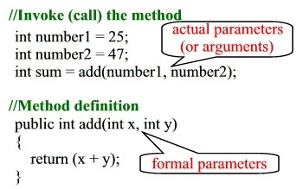
Formal Parameter/arguments
Arguments which are mentioned in the definition of the function is called formal arguments.
Formal arguments are very similar to local variables inside the function.

Slide 28
Global Variable
Global variables are defined outside a function, usually on top of the program.
Global variables hold their values throughout the lifetime of your program and they can be accessed inside any of the functions defined for the program.
A global variable can be accessed by any function.
#include <stdio.h>
int a=10; //global variable
int main()
{
printf("Hello World");
printf("\n%d",a);
return 0;
}

Slide 29
Scope and lifetime of a Variable
A scope is a region of the program, and the scope of variables refers to the area of the program where the variables can be accessed/visible after its declaration. In C every variable is defined in scope.
The lifetime of a variable or function is the time duration for which memory is allocated to store it, and when that memory is released. It also refered as extent of a variable.

Slide 30
Scopes
File scope: It Starts at the beginning of the file (also called a translation unit) and ends with the end of the file. It refers only to those identifiers that are declared outside of all functions. File scope identifiers are visible throughout the entire file. Variables that have file scope are global.
Block scope: Begins with the opening { of a block and ends with its associated closing }. However, block scope also extends to function parameters in a function definition. That is, function parameters are included in a function's block scope. Variables with block scope are local to their block.
Function prototype scope: Identifiers declared in a function prototype; visible within the prototype.
Function scope: Begins with the opening { of a function and ends with its closing }.

Slide 31
Storage classes
Storage Classes are used to describe the features of a variable/function.
These features basically include the scope, visibility and life-time which help us to trace the existence of a particular variable during the runtime of a program.
Decides the part of storage to allocate memory for a variable.
Also it determines the scope of a variable
Memory and CPU registers are type of memory where a varaibles value can be stored.
Block -> decides scope->decides lifetime.
Storage class specifiers tell the compiler how to store the variable.

Slide 32
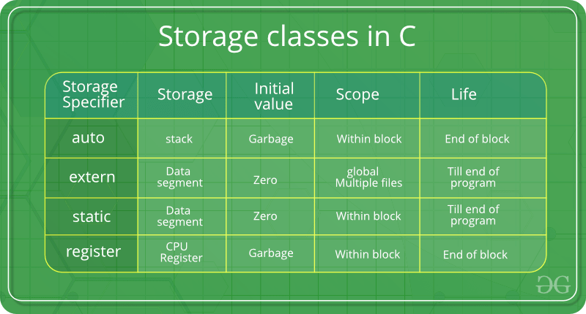
Default value

Slide 33
Types of storage class specifiers
auto
register
extern
static
Syntax or General form of Storage class Specifiers:
storageclass specifier datatype varaiblename;

Slide 34
auto
default storage class of all variables declared inside a function or a block.
Can give same name to more than one variables, which are at different block and scope.
no default value will be assigned.
they will assigned with garbage value by default.
undefined or undetermined behavior.
int main()
{
auto int i;
{
auto int i=2;
{
int i=3;
printf(“%d”,i);
}
printf(“%d”,i);
}
printf(“%d”,i);
}

Slide 35
register:
Registers are faster than memory to access, so the variables which are most frequently used in a C program can be put in registers using register keyword.
A register is a temporary storage area built into a CPU.
register holds the data that the CPU is currently processing whereas, the memory holds the data the that will be required for processing. On the other hands, memory is referred as the main memory of the computer which is RAM.
The keyword register hints to compiler that a given variable can be put in a register.
It’s compiler’s choice to put it in a register or not.

Slide 36
If you use & operator with a register variable then compiler may give an error or warning (depending upon the compiler you are using), because when we say a variable is a register, it may be stored in a register instead of memory and accessing address of a register is invalid.
It is true that, historically, you could not take the address of a register variable.
if no register is available, it will anyways be treated as the default 'auto' class itself. If registers are available, then it would be stored in one.
register keyword can be used with pointer variables. Obviously, a register can have(store) address of a memory location.
Register can not be used with static .
Register can only be used within a block (local), it can not be used in the global scope (outside main).
There is no limit on number of register variables in a C program

Slide 37
int main()
{
register int i = 10;
int* a = &i;
printf("%d", *a);
getchar();
return 0;
}
int main()
{
int i = 10;
register int* a = &i;
printf("%d", *a);
getchar();
return 0;
}
int main()
{
int i = 10;
register static int* a = &i;
printf("%d", *a);
getchar();
return 0;
}
#include <stdio.h>
// error (global scope)
register int x = 10;
int main()
{ // works (inside a block)
register int i = 10;
printf("%d\n", i);
printf("%d", x);
return 0;
}

Slide 38
Static variables:
Static variables have a property of preserving their value even after they are out of their scope.
Hence, static variables preserve the value of their last use in their scope.
So we can say that they are initialized only once and exist till the termination of the program.
Thus, no new memory is allocated because they are not re-declared.
Their scope is local to the function to which they were defined.
Global static variables can be accessed anywhere in the program.
By default, they are assigned the value 0 by the compiler.
static data_type var_name = var_value;

Slide 39
A static int variable remains in memory while the program is running.
A normal or auto variable is destroyed when a function call where the variable was declared is over.
Types:
Local and global static variable
Example for normal / auto variable ie without static:
#include<stdio.h>
int fun()
{
int count = 0;
count++;
return count;
}
int main()
{
printf("%d ", fun());
printf(“\n%d ", fun());
return 0;
}
Output:
1
1

Slide 40
Example for Local static:
#include<stdio.h>
int fun()
{
static int count = 0;
count++;
return count;
}
int main()
{
printf("%d ", fun());
printf(“\n%d ", fun());
return 0;
}
Output:
1
2
Example for Global static:
#include <stdio.h>
void sum();
static int a=10;
int main(){
sum();
sum();
return 0;
}
void sum(){
printf("\n %d",a);
a++;
}

Slide 41
Static variables are allocated memory in data segment, not stack segment.
Static variables (like global variables) are initialized as 0 if not initialized explicitly.
#include <stdio.h>
int main()
{
static int x;
int y;
printf("%d \n %d", x, y);
}
Output:
0 [some_garbage_value]
Static global variables and functions are also possible in C/C++. The purpose of these is to limit scope of a variable or function to a file.
Static variables should not be declared inside structure

Slide 42
Extern
Extern storage class simply tells us that the variable is defined elsewhere and not within the same block where it is used.
Basically, the value is assigned to it in a different block and this can be overwritten/changed in a different block as well.
So an extern variable is a global variable initialized with a legal value where it is declared in order to be used elsewhere. It can be accessed within any function/block.
Also, a normal global variable can be made extern as well by placing the ‘extern’ keyword before its declaration/definition in any function/block.
This basically signifies that we are not initializing a new variable but instead we are using/accessing the global variable only. The main purpose of using extern variables is that they can be accessed between two different files which are part of a large program.

Slide 43
The external storage class is used to tell the compiler that the variable defined as extern is declared with an external linkage elsewhere in the program.
The variables declared as extern are not allocated any memory. It is only declaration and intended to specify that the variable is declared elsewhere in the program.
The default initial value of external integral type is 0 otherwise null.
We can only initialize the extern variable globally, i.e., we can not initialize the external variable within any block or method.
An external variable can be declared many times but can be initialized only once.
If a variable is declared as external then the compiler searches for that variable to be initialized somewhere in the program which may be extern or static. If it is not, then the compiler will show an error.

Slide 44
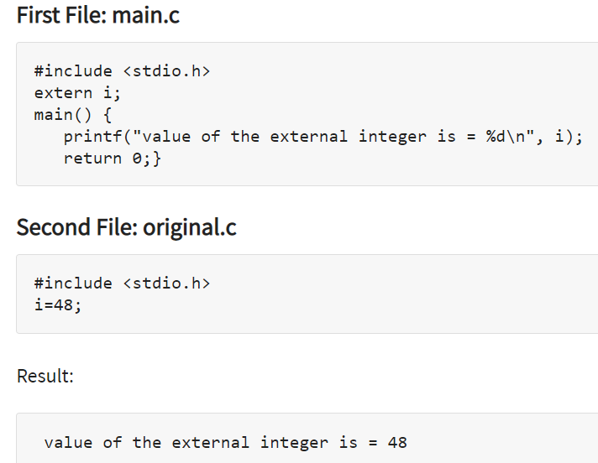

Slide 45
first.c
#include <stdio.h>
int a=10;
main.c
#include <stdio.h>
extern int a;
Void sum();
int main(){
printf("in refernce file %d",a);
Sum();
return 0;}
second.c
#include<stdio.h>
extern int a;
void sum(){
printf("inside sum %d",a);
}

Slide 46
File1.c:
int a=90;
void sum()
{
printf(“inside sum:%d",a);
}
Main1.c:
#include <stdio.h>
int b=100;
void sum();
int main()
{
extern int a, b;
printf("in refernce file %d %d",a,b);sum();
return 0;
}

Slide 47
Constants / literals
Character constants are enclosed between single quotes.
For example, 'a' and '%' are both character constants.
C defines both multibyte characters, which consist of one or more bytes, and wide characters (which are usually 16 bits long).
Multibyte and wide characters are used primarily to represent languages that have large character sets.
To specify a multibyte character, enclose the characters within single quotes, for example, 'xy'.
To specify a wide character constant, precede the character with an L.
For example:
wchar_t wc;
wc = L'Aa';
Here, wc is assigned the wide-character constant equivalent of A.
The type of wide characters is wchar_t, which is defined in the header file, and is not a built-in type.
“Aa” =string

Slide 48
Hexadecimal and Octal Constants, String Constants
Hexadecimal and Octal Constants:
The number system based on 8 is called octal and uses the digits 0 through 7.
The base 16 number system is called hexadecimal and uses the digits 0 through 9 plus the letters A through F, which stand for 10, 11, 12, 13, 14, and 15, respectively.
A hexadecimal constant must consist of a Ox followed by the constant in hexadecimal form.
An octal constant begins with a 0.
Example
int hex = 0x80; /* 128 in decimal */
int oct = 012; /* 10 in decimal */
String constants:
A string is a set of characters enclosed in double quotes. For example, ''this is a test" is a string
Must not confuse strings with characters. A single character constant is enclosed in single quotes, as in 'a'. However, "a" is a string containing only one letter.

Slide 49
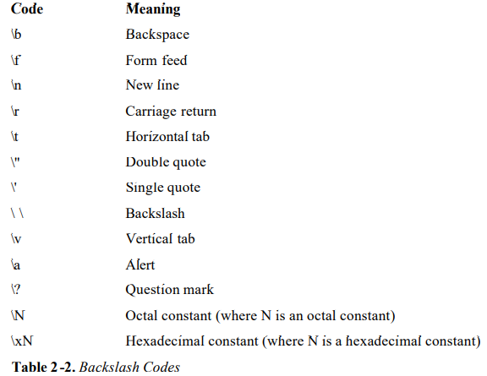
Backslash Character Constants:

Slide 50
operators
An operator is a symbol that tells the compiler to perform specific mathematical or logical functions. C language is rich in built-in operators and provides the following types of operators −
Types based on number of operands:
Unary (involves 1 operand)
Binary (involves 2 operands)
Ternary (involves 3 operands)
Types based on operations:
Arithmetic Operators
Relational Operators
Logical Operators
Bitwise Operators
Assignment Operators
Misc Operators

Slide 51
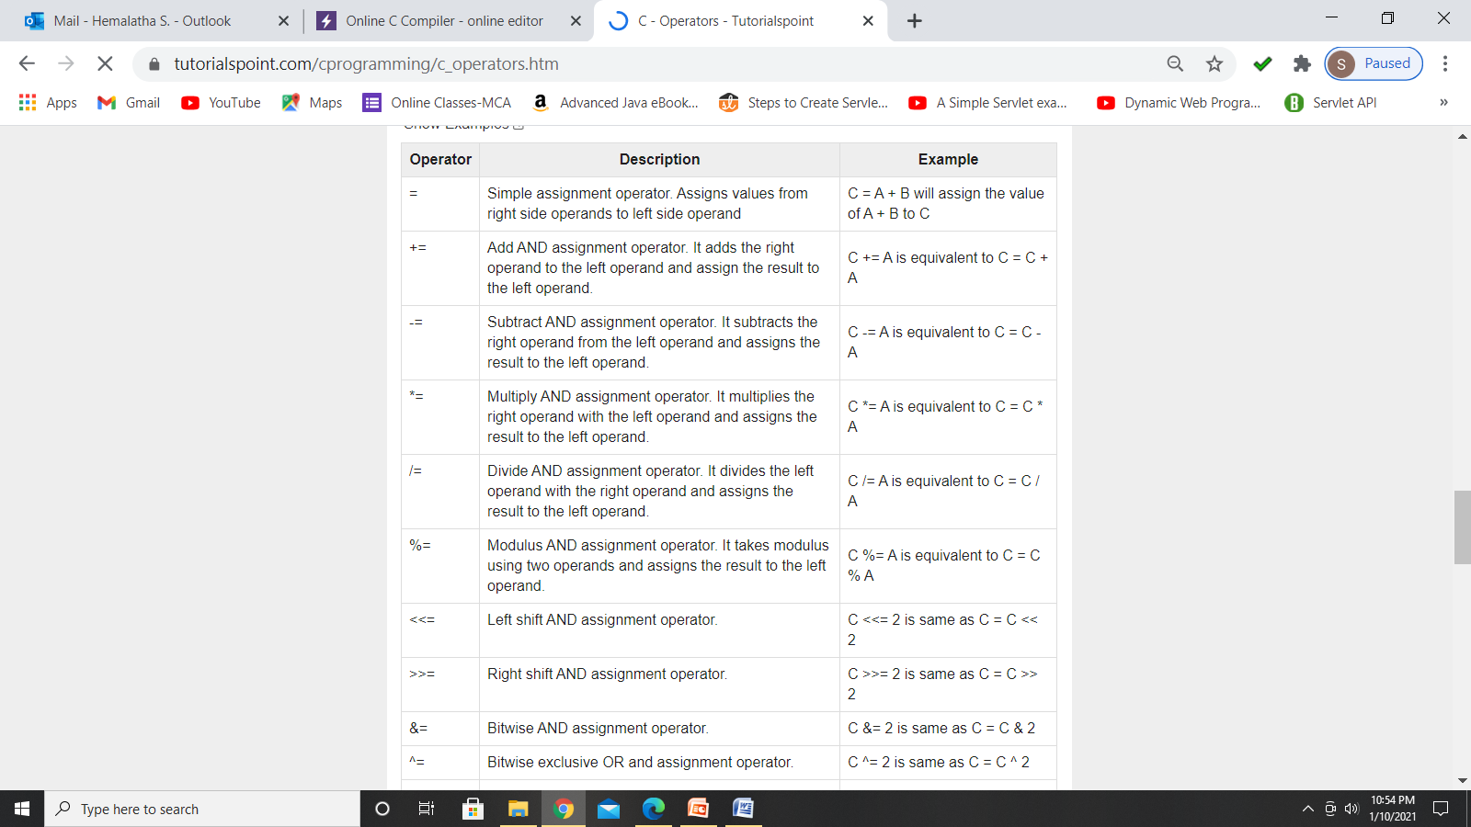
Assignment operator
The general form of the assignment operator is
variable_name = expression;

Slide 52
If that variable can occur on the left side of an assignment statement, it is called a modifiable lvalue/ lvalue.
The term rvalue refers to expressions on the right side of an assignment and simply means the value of an expression.
Type Conversion in Assignments:
When variables of one type are mixed with variables of another type, a type conversion will occur.
In an assignment statement, the type conversion rule is easy: The value of the right side (expression side/rvalue or source) of the assignment is converted to the type of the left side (target variable/lvalue or destination).
int x;
char ch;
float f;
void func(void)
{
ch = x;
x = f;
f = ch;
f = x;
}

Slide 53
When converting from integers to characters and long integers to integers, the appropriate amount of high-order bits will be removed.
In many 16-bit environments, this means that 8 bits will be lost when going from an integer to a character, and 16 bits will be lost when going from a long integer to an integer.
For 32-bit environments, 24 bits will be lost when converting from an integer to a character, and 16 bits will be lost when converting from an integer to a short integer.
Multiple Assignments
You can assign many variables the same value by using multiple assignments in a single statement.
int x,y,z;
x = y = z = 0;
Compound Assignments
There is a variation on the assignment statement, called compound assignment, that simplifies the coding of a certain type of assignment operations.
Compound assignment operators exist for all the binary operators.
For example, x = x+10; can be written as x += 10;
compound assignment is also sometimes referred to as shorthand assignment

Slide 54
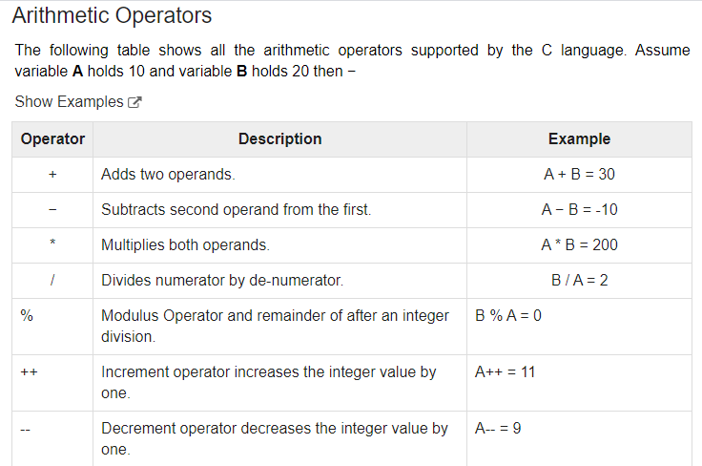

Slide 55
Working of arithmetic operators
#include <stdio.h>
int main()
{
int a = 9,b = 4, c;
c = a+b;
printf("a+b = %d \n",c);
c = a-b;
printf("a-b = %d \n",c);
c = a*b;
printf("a*b = %d \n",c);
c = a/b;
printf("a/b = %d \n",c);
c = a%b;
printf("Remainder when a divided by b = %d \n",c);
return 0;
}
Output:
a+b = 13
a-b = 5
a*b = 36
a/b = 2
Remainder when a divided by b=1
The % operator can only be used with integers.

Slide 56
C Increment and Decrement Operators
To change the value of an operand (constant or variable) by 1.
Increment ++ increases the value by 1 whereas decrement -- decreases the value by 1.
These two operators are unary operators, meaning they only operate on a single operand.
Working of increment and decrement operators
#include <stdio.h>
int main()
{
int a = 10, b = 100;
float c = 10.5, d = 100.5;
printf("++a = %d \n", ++a);
printf("--b = %d \n", --b);
printf("++c = %f \n", ++c);
printf("--d = %f \n", --d);
return 0;
}
Output
++a = 11
--b = 99
++c = 11.500000
--d = 99.500000

Slide 57
Prefix and postfix :
When an increment or decrement operator precedes its operand, the increment or decrement operation is performed before obtaining the value of the operand for use in the expression.
For instance,
x = 10;
y = ++x;
sets y to 11 and x to 11.
Explanation:
First increments x by 1 as x=x+1; (ie x=10+1, so x=11)
Then assigns the x value to y as y=x;(ie y=11)
If the operator follows its operand, the value of the operand is obtained before incrementing or decrementing it.
Example,
x = 10;
y = x++;
y is set to 10 and x is set to 11;
Explanation:
First assigns x value to y as y=x; (ie y=x , so y=10)
Then increments x value by 1 as x=x+1;(ie x=10+1, so x=11)

Slide 58
int x=10;
int y=++x;
printf(“%d%d”,y,x); // output: 11 11
int y=++10; //output: error
++ and – operators can be applied only to variable not to the constant values/literals.
int a=5;
printf(“%d”,a++); o/p : 5
printf(“%d”,a); o/p:6
int a=5;
printf(“%d”,++a); o/p : 6
printf(“%d”,a); o/p:6
int y=5;
printf("%d%d",y++,y);
o/p in turbo c++ : 5 5 (evaluated from left to right ), but in online compiler 5 6

Slide 59
Int a=5; printf("%d%d%d",a++,a++,++a`);
Turbo: 7 6 6
Gcc: 7 6 8
Turbo c:
the parameter are evaluated in Right to Left order. Here they are assigned to the format specifier as soon as they are evaluated.
++a is pre-increment operator. So value of a becomes 6 and is assigned to the last %d.
a++ is post-increment operator. So value of a , which is 6 is assigned to 2nd %d and then gets incremented to 7.
Same happens with the 1st a++. Hence the values 766 are printed to console.
Gcc compiler:
the parameter are evaluated in Right to Left order. However, they are not assigned as soon as they get evaluated but according to the nature of operator (pre or post).
++a is pre-increment operator. So value of a becomes 6 but is not assigned to the last %d.
a++ is post increment operator. So value of a , which is 6 is assigned to 2nd %d and then gets incremented to 7.
The same thing happens with the 1st a++. The value, which is 7 is assigned to the 1st %d and then incremented to 8.
Lastly, the value of a gets assigned to the 3rd %d. Hence the values 768 gets printed to the console.

Slide 60
int i=0;
printf("%d %d %d %d %d",++i,--i,i++,--i,i++);
GCC: 1 1 0 1 0
Turbo:1 0 0 0 0
int a=2;
int b=++a + ++a ; (left to right)
printf("%d %d",b,a);
Turbo : 7 4
GCC: 8 4

Slide 61
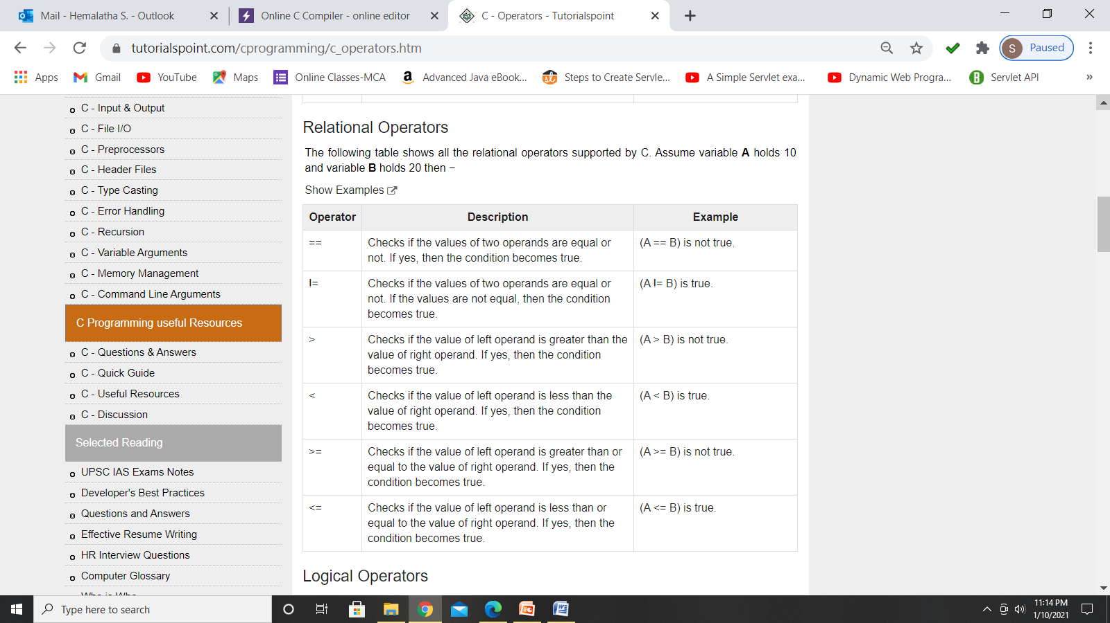

Slide 62
Relational operators are used to compare values of two expressions.
A relational operator checks the relationship between two operands.
Relational operators are binary operators because they require two operands to operate.
An expression which contains the relational operators is called relational expression.
used in decision making and loops.
In C, all non-zero values are considered as true ( 1 ) while 0 is considered as false.

Slide 63
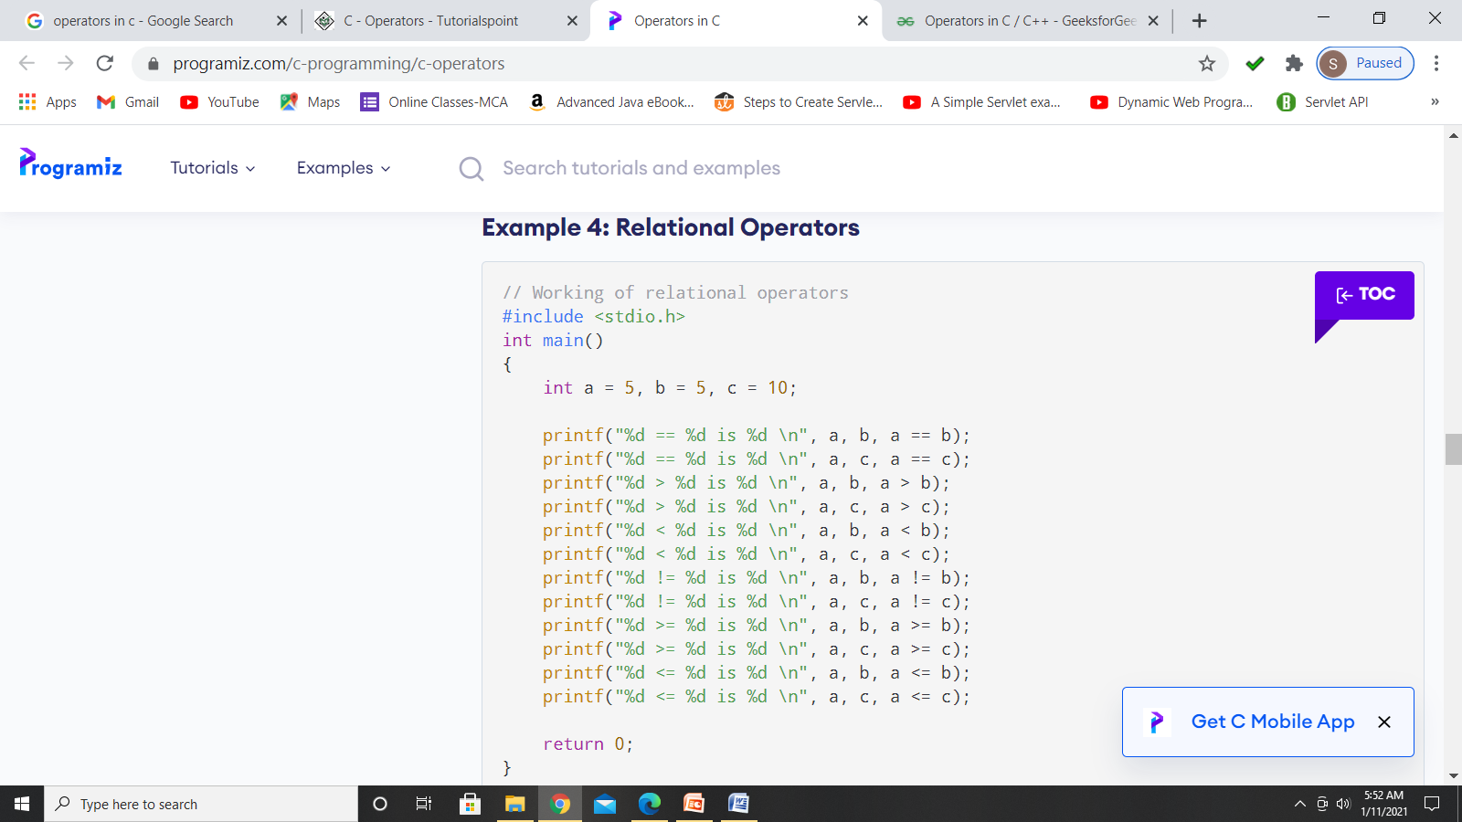
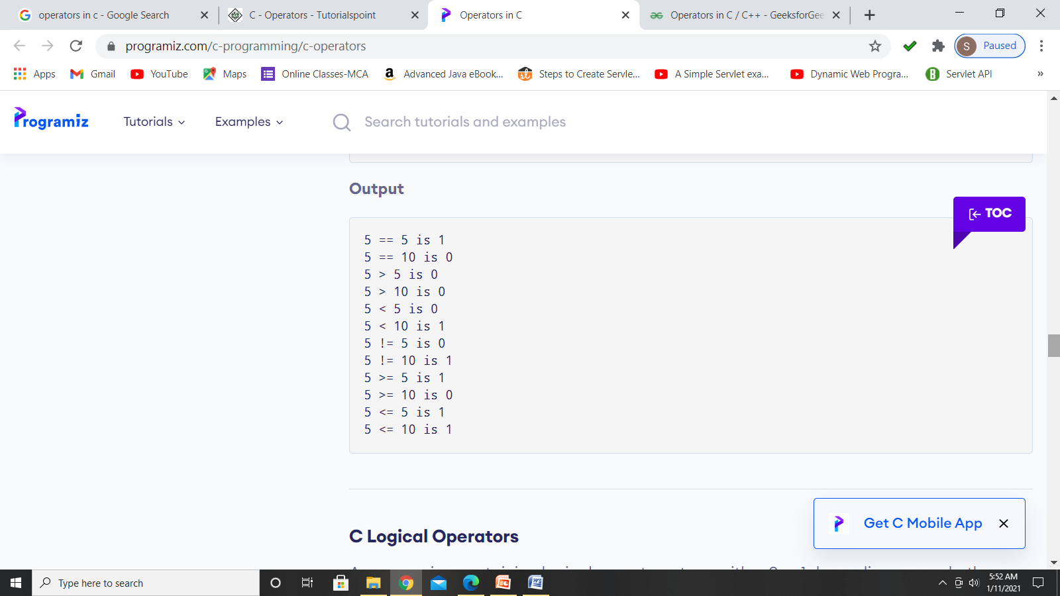

Slide 64
Logical operators
Logical operators are used to evaluate two or more conditions.
A logical operator is a symbol used to connect two or more expressions.
The operands of logical-AND and logical-OR expressions are evaluated from left to right.
If the value of the first operand is sufficient to determine the result of the operation, the second operand is not evaluated. This is called "short-circuit evaluation."

Slide 65
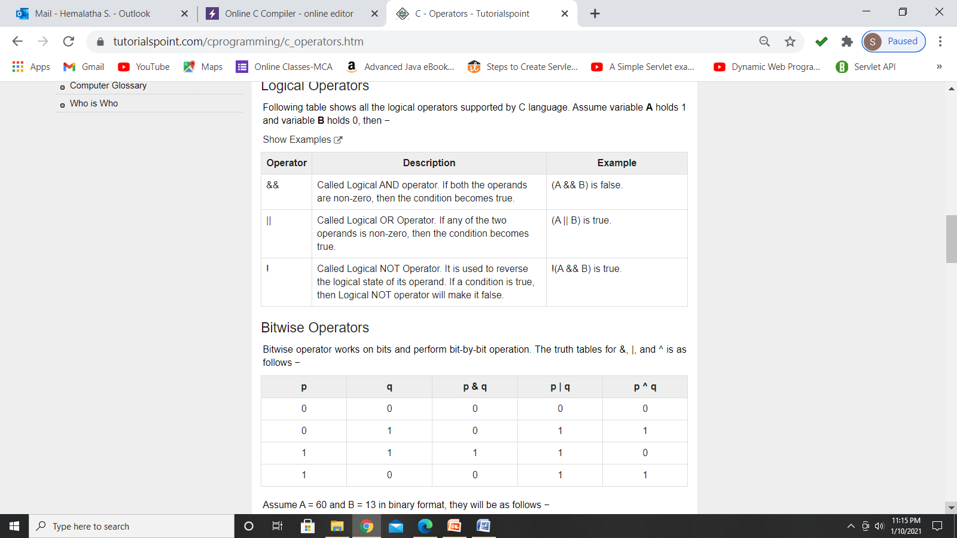

Slide 66
#include <stdio.h>
int main()
{
int a=10,b=0;
if ( ( a>b ) || ( a/b == 0 ) )
printf("hai");
else
printf("false");
return 0;
}
what is the output of the following code?
hai
false
error
#include <stdio.h>
int main()
{
int a=10,b=0;
if ( ( a>b ) | ( a/b == 0 ) )
printf("hai");
else
printf("false");
return 0;
}
what is the output of the following code?
hai
false
error

Slide 67
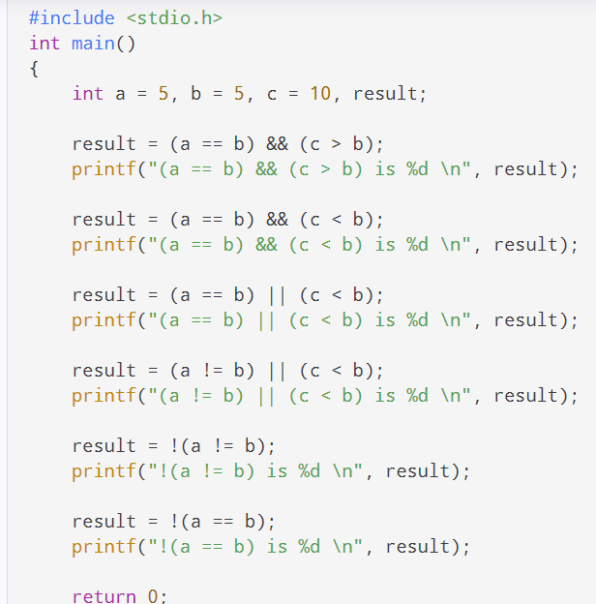
Output
(a == b) && (c > b) is 1
(a == b) && (c < b) is 0
(a == b) || (c < b) is 1
(a != b) || (c < b) is 0
!(a != b) is 1
!(a == b) is 0

Slide 68
Relational operators compare values and return either TRUE or FALSE.
Logical operators perform logical operations on TRUE and FALSE.
relational operators return the integers 0 or 1, where 0 stands for false and any non-zero value stands for true.
These operators are used for decision making in C language.

Slide 69
Bitwise operator
BITWISE OPERATORS are used for manipulating data at the bit level, also called bit level programming.
They are used in numerical computations to make the calculation process faster.

Slide 70
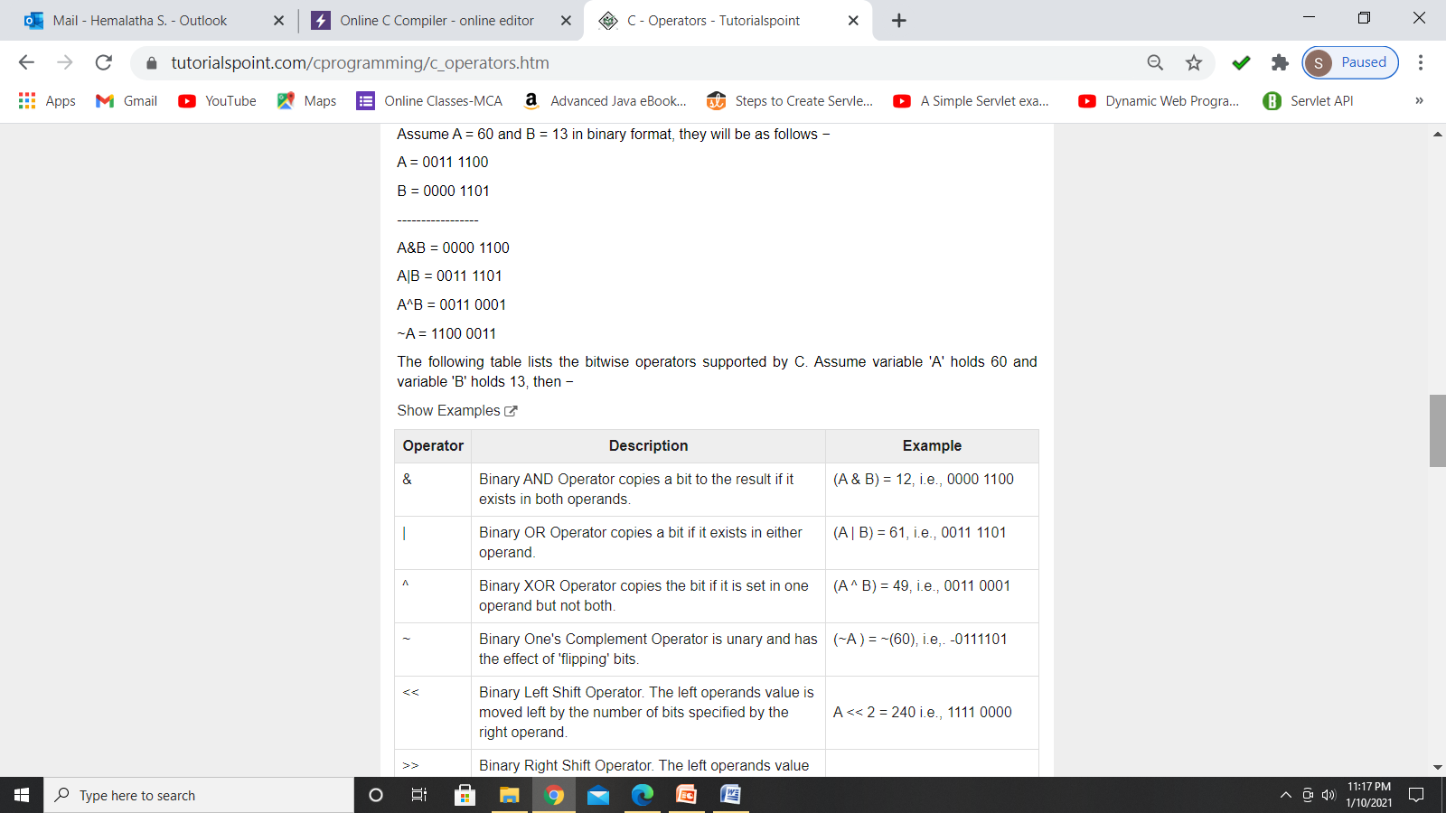
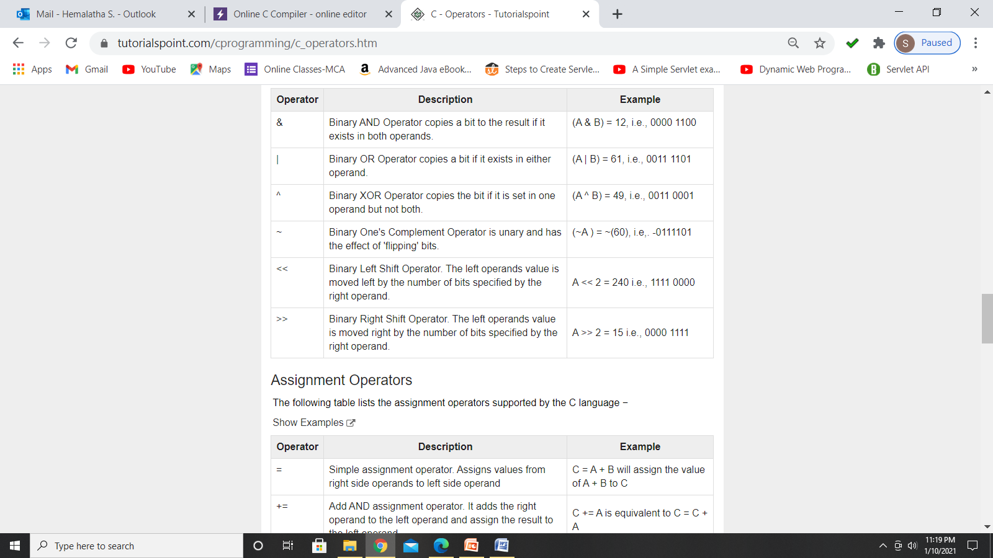

Slide 71
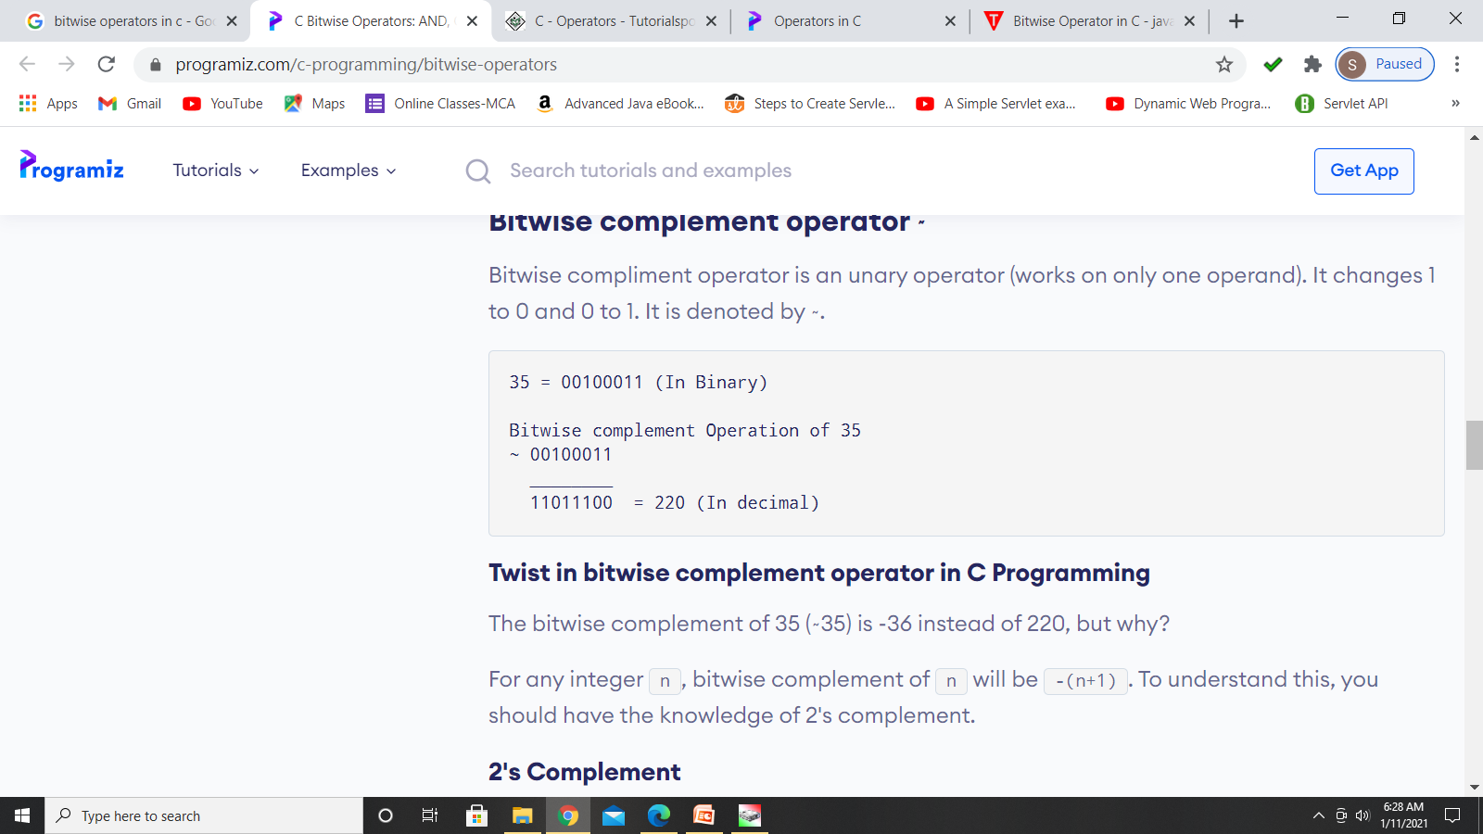
#include <stdio.h>
int main()
{
int a=6, b=14; // variable declarations
printf("The output of the Bitwise AND operator a&b is %d",a&b);
return 0;
}
Binary representation of a and b are in 32-bit architecture(ie 2bytes for int)
a AND b = 0000000000000110 && 0000000000001110 = 0000000000000110

Slide 72
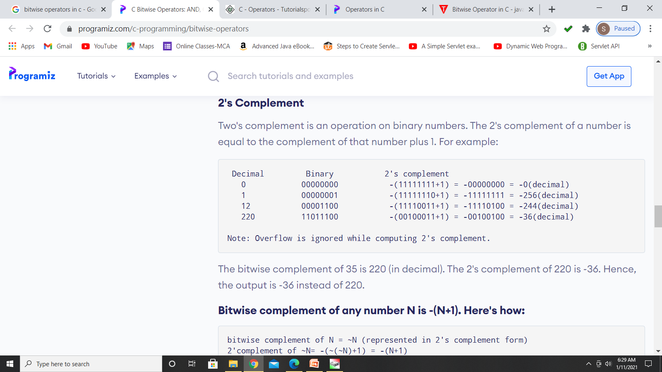

Slide 73
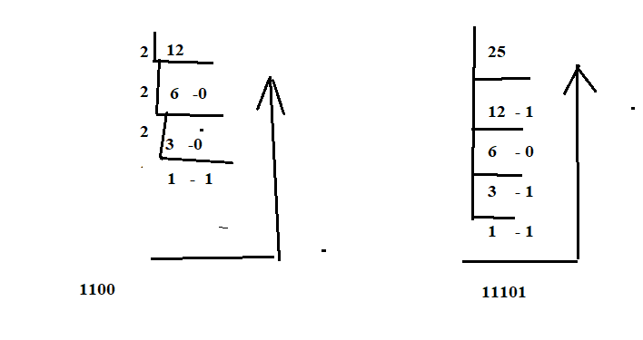
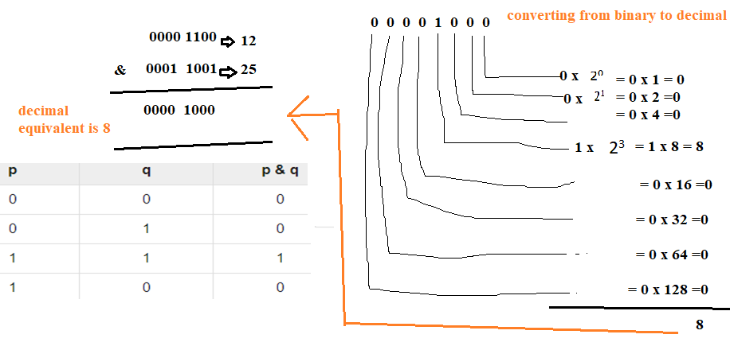
0
11001

Slide 74
Left-shift operator
It is an operator that shifts the number of bits to the left-side.
perform n*2 for given number of times (short cut method) or left shifting an integer “x” with an integer “y” (x<<y) is equivalent to multiplying x with 2^y (2 raise to power y).
Syntax of the left-shift operator is given below:
Operand << n;
Where,
Operand is an integer expression on which we apply the left-shift operation.
n is the number of bits to be shifted.
In the case of Left-shift operator, 'n' bits will be shifted on the left-side. The 'n' bits on the left side will be popped out, and 'n' bits on the right-side are filled with 0.
Example
Suppose we have a statement: int a = 5;
The binary representation of 'a' is given : a = 0101
a << 2;
00000101<<2 = 00010100
#include <stdio.h>
int main()
{ int a=5; // variable initialization
printf("The value of a<<2 is : %d ", a<<2); return 0;
}

Slide 75
Right-shift operator : perform n/2 for given number of times. (short cut method) or dividing x with 2^y
It is an operator that shifts the number of bits to the right side.
Syntax of the right-shift operator is given below:
Operand >> n;
Where,
Operand is an integer expression on which we apply the right-shift operation.
N is the number of bits to be shifted.
In the case of the right-shift operator, 'n' bits will be shifted on the right-side. The 'n' bits on the right-side will be popped out, and 'n' bits on the left-side are filled with 0.

Slide 76
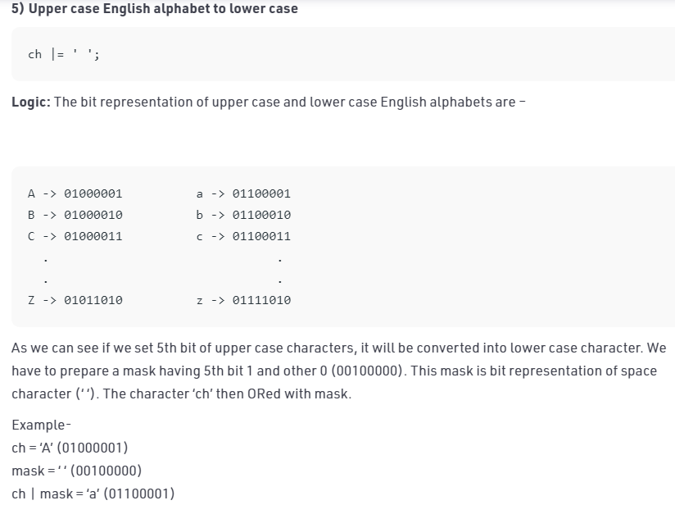
Extras in bit operations

Slide 77
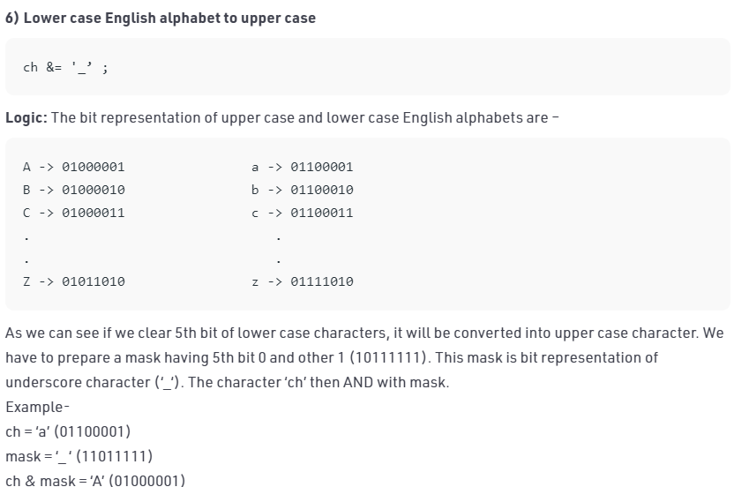

Slide 78
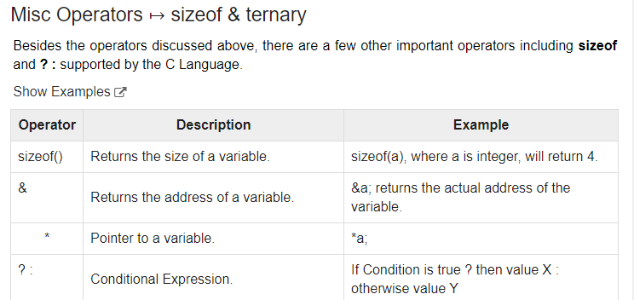
Comma Operator
Comma operators are used to link related expressions together.
For example:
int a, c = 5, d;

Slide 79
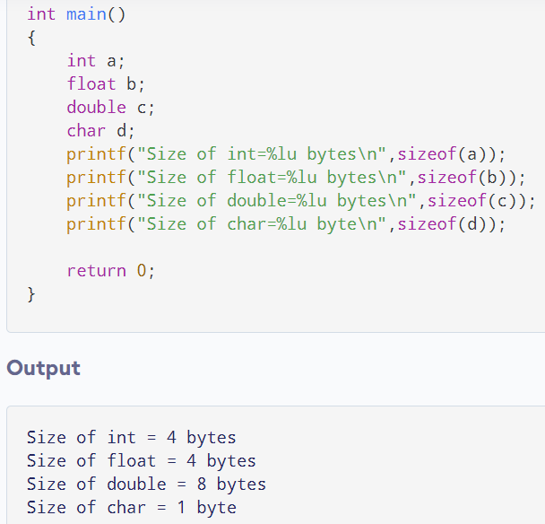
Sizeof() operator will be called as compile time operator

Slide 80
Dot(.) and Arrow(->) operators:
In C, the . (dot) and the –> (arrow) operators access individual elements of structures and unions.
Structures and unions are compound data types that may be referenced under a single name
The [ ] and ( ) Operators :
Parentheses ()are operators that increase the precedence of the operations inside them.
Square brackets []perform array indexing.

Slide 81
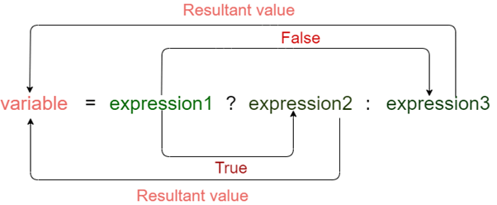
Conditional Operator in C
The conditional operator is also known as a ternary operator.
The conditional statements are the decision-making statements which depends upon the output of the expression.
It is represented by two symbols, i.e., '?' and ':'.
As conditional operator works on three operands, so it is also known as the ternary operator.
The behavior of the conditional operator is similar to the 'if-else' statement
Syntax of a conditional operator
Expression1? expression2: expression3;

Slide 82
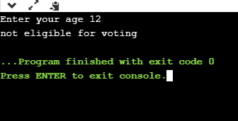
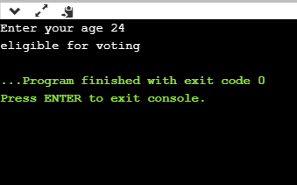
#include <stdio.h>
int main()
{
int age;
printf("Enter your age");
scanf("%d",&age);
(age>=18)? (printf("eligible for voting")) : (printf("not eligible for voting"));
return 0;
}

Slide 83
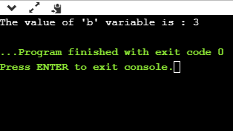
#include <stdio.h>
int main()
{
int a=5,b; // variable declaration
b=((a==5)?(3):(2)); // conditional operator
printf("The value of 'b' variable is : %d",b);
return 0;
}
Difference between if-else and conditional operator:
A conditional operator is a single programming statement, while the 'if-else' statement is a programming block in which statements come under the parenthesis.
A conditional operator can also be used for assigning a value to the variable, whereas the 'if-else' statement cannot be used for the assignment purpose.
It is not useful for executing the statements when the statements are multiple, whereas the 'if-else' statement proves more suitable when executing multiple statements.
The nested ternary operator is more complex and cannot be easily debugged, while the nested 'if-else' statement is easy to read and maintain.

Slide 84
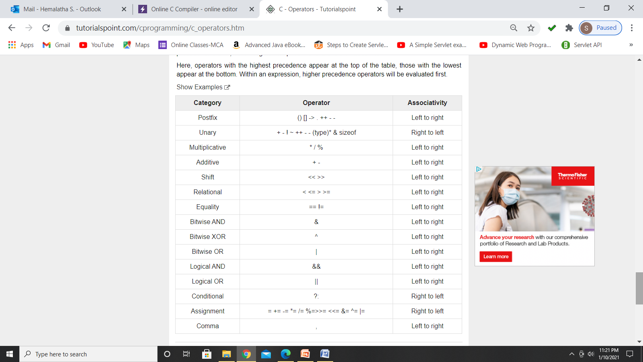
Operator Precedence and Associativity
Determines how an expression is evaluated. It defines the order in which operators of the same precedence are evaluated in an expression. Associativity can be either from left to right or right to left.

Slide 85
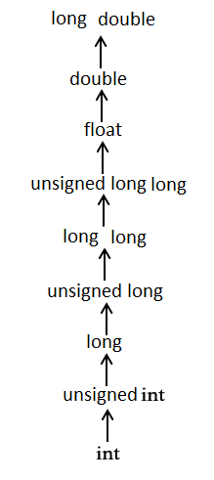
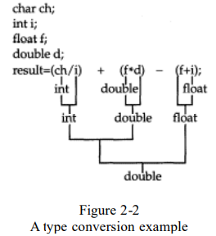
Type Conversion in Expressions
When constants and variables of different types are mixed in an expression, they are all converted to the same type.
The compiler converts all operands up to the type of the largest operand, which is called type promotion.
First, all char and short int values are automatically elevated to int. This process is called integral promotion.
Short and char

Slide 86
Type Casting or type conversion:
Type casting refers to changing an variable of one data type into another.
Two types:
Implicit conversion (also known as ‘automatic type conversion’)
explicit conversion
Implicit conversion:
When the type conversion is performed automatically by the compiler without programmers intervention, such type of conversion is known as implicit type conversion or type promotion.
Example:
short a=10;
int b;
b=a; //implicit type casting

Slide 87
Important Points about Implicit Conversions:
Implicit type of type conversion is also called as standard type conversion. We do not require any keyword or special statements in implicit type casting.
Converting from smaller data type into larger data type is also called as type promotion. In the above example, we can also say that the value of s is promoted to type integer.
The implicit type conversion always happens with the compatible data types.
We cannot perform implicit type casting on the data types which are not compatible with each other such as:
Converting float to an int will truncate the fraction part hence losing the meaning of the value.
Converting double to float will round up the digits.
Converting long int to int will cause dropping of excess high order bits.
In all the above cases, when we convert the data types, the value will lose its meaning. Generally, the loss of meaning of the value is warned by the compiler.

Slide 88
Converting Character to Int
void main()
{
int number = 1;
char character = 'k'; /*ASCII value is 107 */
int sum;
sum = number + character; //(first all characters and shorts in an expression will converted to int –integral promotion)
printf("Value of sum : %d\n", sum );
}
Output:
Value of sum : 108

Slide 89
Explicit conversion:
You can force an expression to be of a specific type by using a cast.
The general form of a cast is
(type) expression;
#include<stdio.h>
int main() {
float a = 1.2;
//int b = a;
int b = (int)a + 1; //correct way of conversion
printf("Value of a is %f\n", a);
printf("Value of b is %d\n",b);
return 0;
}
Output:
Value of a is 1.200000
Value of b is 2

Slide 90
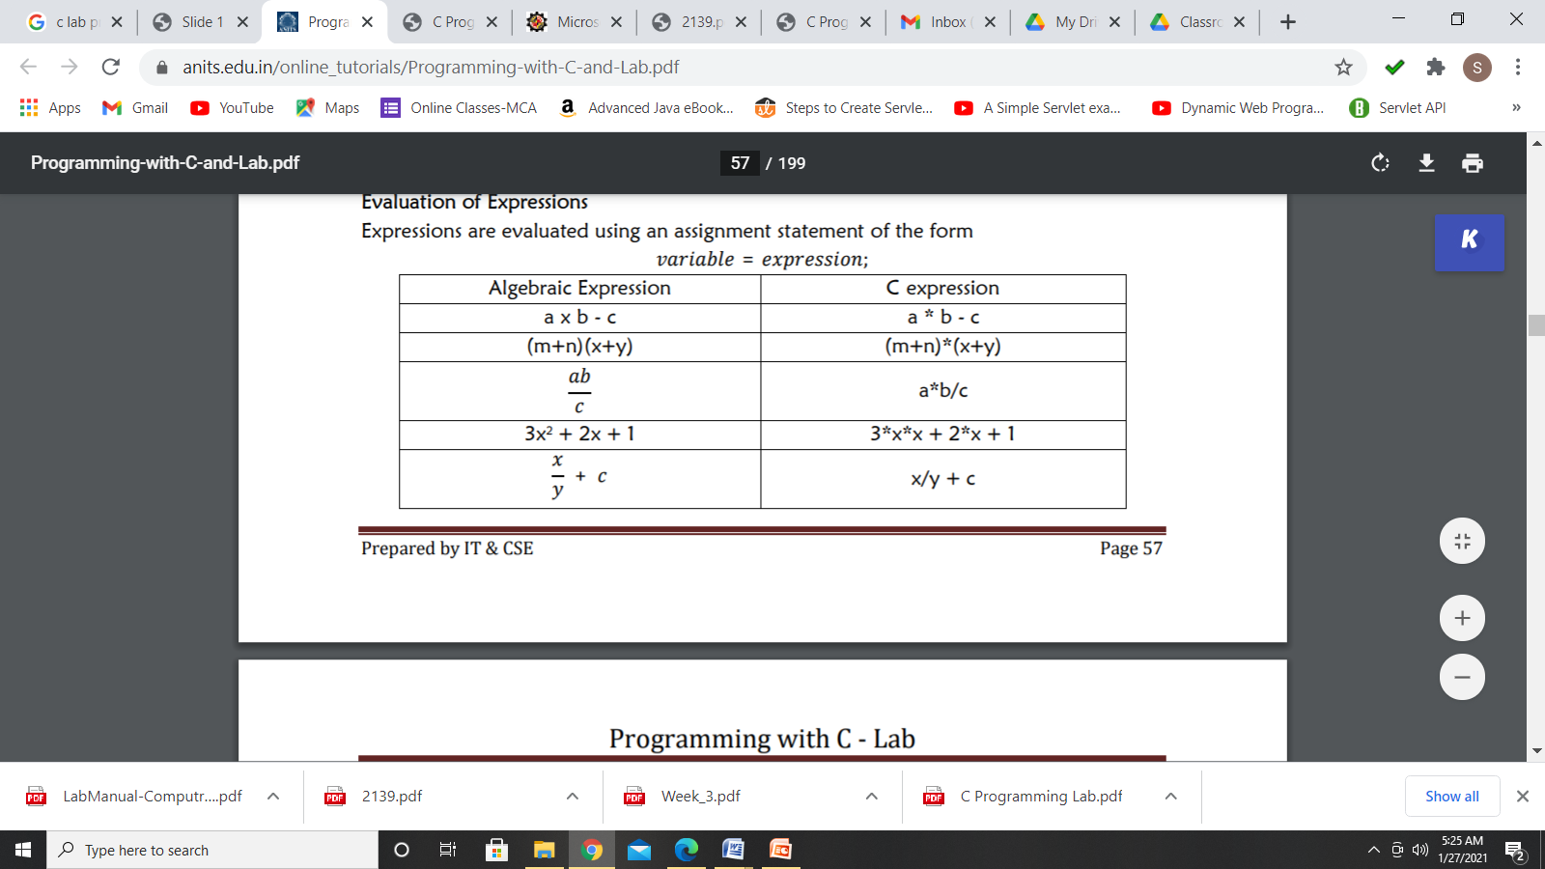

Slide 91
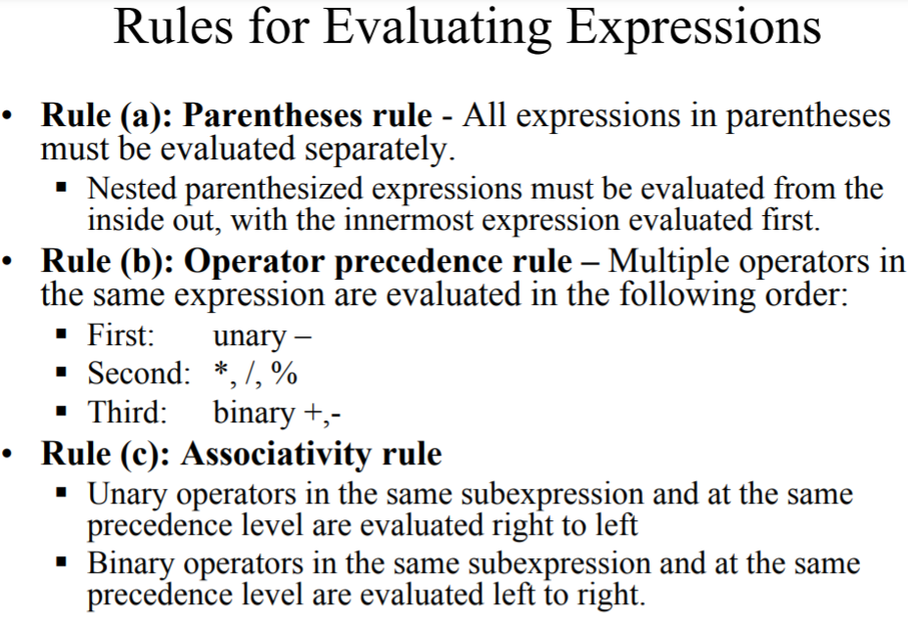

Slide 92
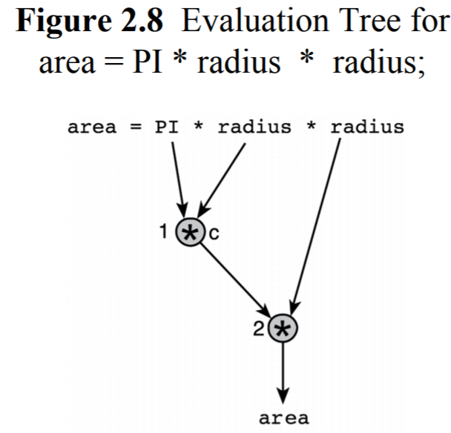

Slide 93
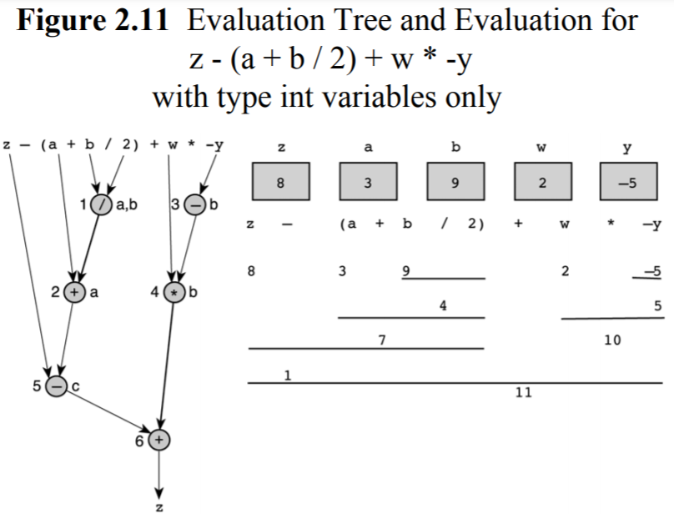

Slide 94
Summary on type conversion
Typecasting is also called as type conversion
It means converting one data type into another.
Converting smaller data type into a larger one is also called as type promotion.
'C' provides an implicit and explicit way of type conversion.
Implicit type conversion operates automatically when the compatible data type is found.
Explicit type conversion requires a type casting operator.

Slide 95
int main()
{
printf( "%c\n", (char)65 );
getchar();
}

Slide 96
statements
A statement is a part of your program that can be executed. That is, a statement specifies an action.
C categorizes statements into these groups:
Selection (if and switch)
Iteration (while, for, and do-while)
Jump (break, continue, goto, and return)
Label (case and default, goto)
Expression (composed of a valid expression)
Block (starting with { and end with } ->compound statements)
Note: pink color represents control flow statements or control strcutures

Slide 97
Control structures or control flow statements
Control structures are used to alter the flow of execution of the program.
Mainly for decision making.
use control structures to make decisions and alter the direction of program flow in one or the other path(s) available.
There are three types of control structures available in C
1) Sequence structure (straight line paths)
2) Selection structure/branching (one or many branches)
3)Loop structure/iterative (repetition of a set of activities)
4) jump structure

Slide 98
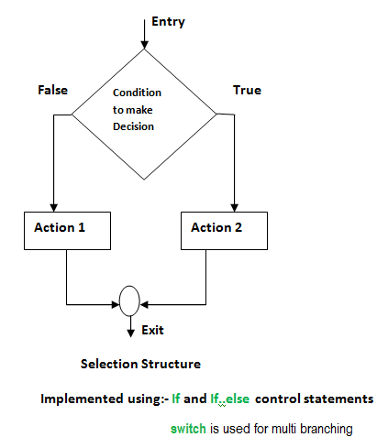
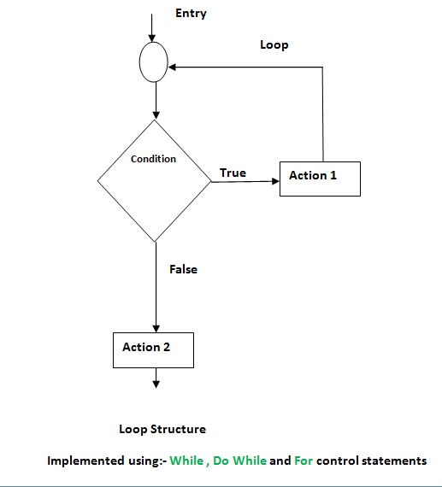
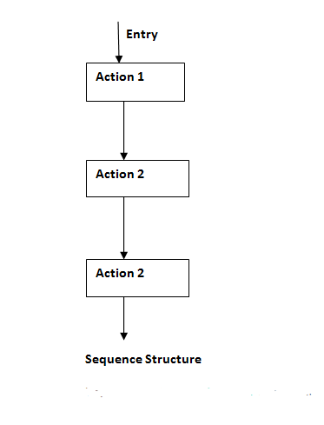

Slide 99
If statements
The syntax of simple if statement
if (expression/value(condition)) { statement 1; statement 2; } statement 1;
statement 2;
if (expression)
statement;
Example:
void main() { int num; printf("Hello user, Enter a number"); scanf("%d",&num); //10 //1 if(num==1) { printf("UNITED STATES"); }
printf(“outside if”);
}
Output: outside if
void main() { int num; printf("Hello user, Enter a number"); scanf("%d",&num); //10 //1 if(num==1) printf("UNITED STATES"); printf(“outside if”);
}

Slide 100
If..else statements:
if (expression)
{
Block of statements(true part);
}
else
{
Block of statements(false part);
}
Example:
#include <stdio.h>
int main(){
int age;
printf("Enter your age:");
scanf("%d",&age);
if(age >=18) {
printf("You are eligible for voting");
}
else
{
printf("You are not eligible for voting");
}
return 0;
}

Slide 101
?: (conditional operator/ternary operator):
if condition is true ? then X return value : otherwise Y value;
Example:
#include <stdio.h>
int main()
{
int age; // variable declaration
printf("Enter your age");
scanf("%d",&age); // taking user input for age variable
(age>=18)? (printf("eligible for voting")) : (printf("not eligible for voting")); // conditional operator
return 0;
}
#include <stdio.h>
int main()
{
int a=5,b; // variable declaration
b=((a==5)?(3):(2)); // conditional operator
printf("The value of 'b' variable is : %d",b);
return 0;
}

Slide 102
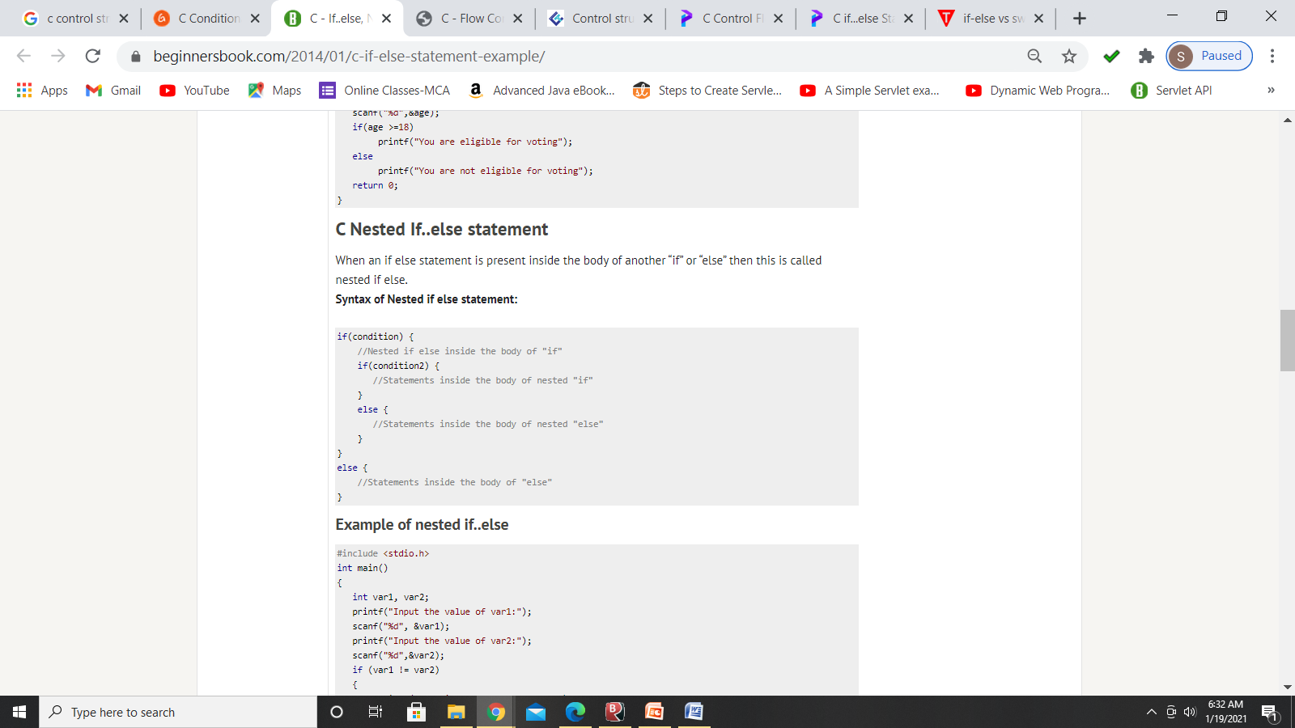
Example:
#include <stdio.h>
int main()
{ int var1, var2;
printf("Input the value of var1:");
scanf("%d", &var1);
printf("Input the value of var2:");
scanf("%d",&var2);
if (var1 != var2)
{
printf("var1 is not equal to var2\n");
if (var1 > var2){
printf("var1 is greater than var2\n");
}
else
{printf("var2 is greater than var1\n");
}
}
else
{
printf("var1 is equal to var2\n");
}
return 0; }

Slide 103
if(cond)
{
if(cond)
{
if(cond)
{
True part of inner if;
}
else
{
False part of inner if;
}
}
else
{
False part of inner if;
}
}
else
{
False part of the condition;
}

Slide 104
If…else ladder:
if (test expression1)
{ // statement(s) }
else if(test expression2)
{ // statement(s) }
else if (test expression3)
{ // statement(s) }
. .
else { // statement(s) }
Example:
#include <stdio.h>
int main()
{
int var1, var2;
printf("Input the value of var1:");
scanf("%d", &var1);
printf("Input the value of var2:");
scanf("%d",&var2);
if (var1 !=var2) {
printf("var1 is not equal to var2\n");
}
else if (var1 > var2) {
printf("var1 is greater than var2\n"); }
else if (var2 > var1) {
printf("var2 is greater than var1\n");
}
else
{ printf("var1 is equal to var2\n");
}
return 0;
}

Slide 105
Switch statement
switch( expression ) {
case constant-expression1: statements1;
[case constant-expression2: statements2;]
[case constant-expression3: statements3;]
[default : statements4;]
}
Example:
#include <stdio.h>
main() {
int Grade = ‘H';
switch( Grade ) {
case 'A' : printf( "Excellent\n" );
break;
case 'B' : printf( "Good\n" );
break;
case 'C' : printf( "OK\n" );
break;
case 'D' : printf( "Mmmmm....\n" );
break;
case 'F' : printf( "You must do better than this\n" );
break;
default : printf( "What is your grade anyway?\n" );
break; } }

Slide 106
Free flowing switch or without break:
#include <stdio.h>
main() {
int Grade = ‘D';
switch( Grade )
{
case 'A' : printf( "Excellent\n" );
case 'B' : printf( "Good\n" );
case 'C' : printf( "OK\n" );
case 'D' : printf( "Mmmmm....\n" );
case 'F' : printf( "You must do better than this\n" );
default : printf( "What is your grade anyway?\n" );
} }

Slide 107
Default case:
#include <stdio.h>
main() {
int Grade = 'L';
switch( Grade ) {
case 'A' : printf( "Excellent\n" );
break;
case 'B' : printf( "Good\n" );
break;
case 'C' : printf( "OK\n" );
break;
case 'D' : printf( "Mmmmm....\n" );
break;
case 'F' : printf( "You must do better than this\n" );
break;
//default : printf( "What is your grade anyway?\n" );
//break;
} }
/*…
….
..
*/

Slide 108
Nested switch Statements:
switch(x)
{
case 1: switch(y)
{
case 0: printf(''Divide by zero error.\n");
break;
case 1: process(x, y);
break;
}
break;
case 2: . . .
}

Slide 109
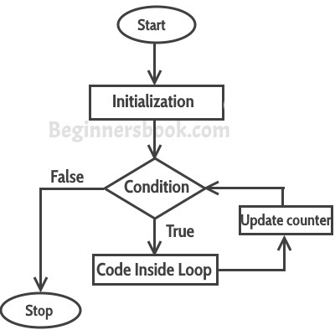
Looping or iterative statements
for Loop
The syntax of the for loop is:
for (initializationStatement; testExpression; update/iterativeStatement)
{ // statements inside the body of loop }
// Print numbers from 1 to 10
#include <stdio.h>
int main() {
int i;
for (i = 1; i < 11; ++i)
{
printf("%d ", i);
}
return 0; }

Slide 110
Different forms of for loop
You can skip the initialization of the counter variable & it can be declared before the loop.
Example:
#include <stdio.h>
int main()
{
int counter=1;
for(; counter<=10; counter=counter+1)
{
printf("%dn", counter);
}
return 0;
}
Output: prints from 1…10
Note: You can skip the initialization of the counter variable, but the semicolon before the test condition should be present, otherwise it will throw compilation error.

Slide 111
You can also skip the incrementing or decrementing of the counter. But in this scenario the counter should be incremented inside the for-loop body.
Example:
#include <stdio.h>
int main()
{
int counter;
for (counter=1; counter<=10;)
{
printf("%dn", counter);
counter=counter+1
}
return 0;
}
You can skip the condition in the for loop, which will result in an infinite loop.
Example:
#include <stdio.h>
int main()
{
int counter;
for (counter=1; ; counter++)
{
printf("%dn", counter);
}
return 0;
}
Output:
Infinte Loop

Slide 112
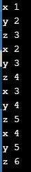
We can initialize more than one variable in for loop.
Example:
#include <stdio.h>
int main()
{
int x, y, z;
for (x=1, y=2, z=3; x<5 ; x++, y++, z++)
{
printf("x %dn", x);
printf("y %dn", y);
printf("z %dn", z);
}
return 0;
}
Output:
Nested for loop in C
You can put one for loop inside another for loop in C. This is called nested for loop.

Slide 113
Repeating same set of instructions again and again in more number of places
main()
{
int i=1;
{
printf(“%d”,i);
++i;
}
{
printf(“%d”,i);
++i;
}
{
printf(“%d”,i);
++i;
}
….
…
..
{
printf(“%d”,i);
++i;
}
}

Slide 114
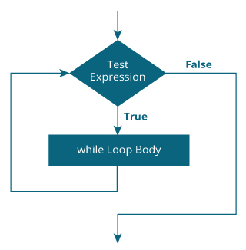
The syntax of the while loop is:
while (testExpression)
{ // statements inside the body of the loop }
Example:
#include <stdio.h>
int main()
{
int i = 1;
while (i <= 5)
{
printf("%d\n", i);
++i;
}
return 0; }
A=++i;
A=i++;

Slide 115
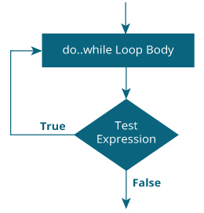
The syntax of the do...while loop is:
do {
// statements inside the body of the loop
}
while (testExpression);
Example:
#include <stdio.h>
int main() {
double number, sum = 0;
// the body of the loop is executed at least once
do {
printf("Enter a number: ");
scanf("%lf", &number);
sum += number; }
while(number != 0.0);
printf("Sum = %.2lf",sum);
return 0; }

Slide 116
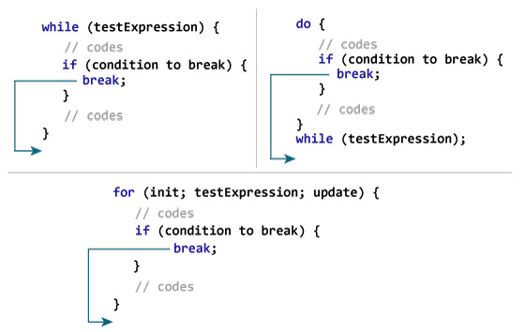
C break
The break statement ends the loop immediately when it is encountered.
Its syntax is:
break;
The break statement is almost always used with if...else statement inside the loop.

Slide 117
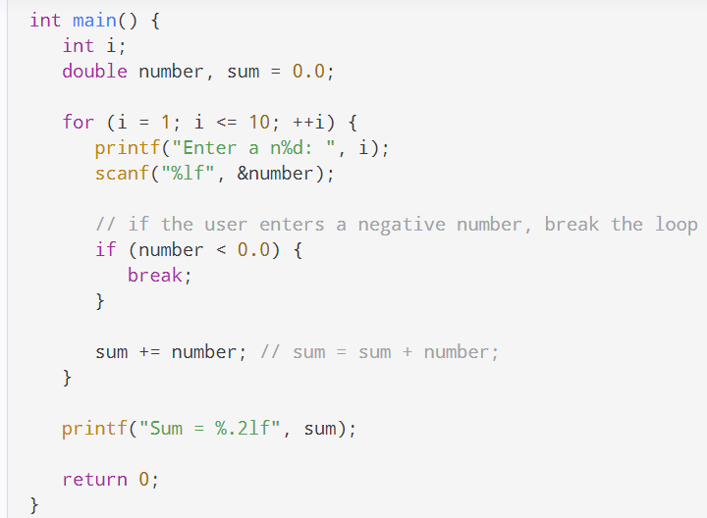
Enter a n1: 2.4
Enter a n2: 4.5
Enter a n3: 3.4
Enter a n4: -3
Sum = 10.30

Slide 118

C continue
The continue statement skips the current iteration of the loop and continues with the next iteration.
Its syntax is:
continue;
The continue statement is almost always used with the if...else statement.

Slide 119


Slide 120
Syntax of goto Statement
goto label;
... .. ...
... .. ...
label: statement;
The fact that 'goto' can do anything is exactly why we don't use it.“
#include <stdio.h>
int main () {
int a = 10;
LOOP: do { if( a == 15)
{
a = a + 1;
goto LOOP;
}
printf("value of a: %d\n", a);
a++;
}
while( a < 20 );
return 0; }
When the above code is compiled and executed, it produces the following result −
value of a: 10
value of a: 11
value of a: 12
value of a: 13
value of a: 14
value of a: 16
value of a: 17
value of a: 18
value of a: 19

Slide 121

return
The return statement returns the flow of the execution to the function from where it is called.
As soon as the statement is executed, the flow of the program stops immediately and return the control from where it was called.
Returning control from function that does not return value: return;
Returning control from function that returns value:
return[expression/value];

Slide 122

void func()
{ return; }
This syntax is used in function just as a jump statement in order to break the flow of the function and jump out of it. One can think of it as an alternative to “break statement” to use in functions.
Program list
Write a C program to find the given number is odd or even
Write a C program to calculate the factorial of a given number.
Write a C program to generate the fibonacci series.
Write a program to determine whether the input character is capital or small letter, digits or special symbol.
Write a Program to Check Whether a Number is Prime or not.
Write a program to find the largest and smallest among three given numbers.
Write a program to find the largest and smallest among three given numbers and also display whether the identified largest/smallest number is even or odd.
Write a program to find whether a character is consonant or vowel using switch statement.
Write a program to print day name using switch case.
Write a program to check whether a number is positive, negative or zero using switch case.
Write a program to compute grade of students using if else adder. The grades are assigned as followed:

Slide 123
Write a program to check whether the entered year is leap year or not (a year is leap if it is divisible by 4 and divisible by 100 or 400.)
Write a program to check number is Armstrong or not. (Hint: A number is Armstrong if the sum of n^{th} power of their individual digits of a number is equal to the number itself).
Example:
Given 1212, Here , no of digits is 4 (ie n=4 => 1^{n}+2^{n}+1^{n}+2^{n)}
So, =1⁴ + 2⁴ + 1⁴ + 2⁴
= 1+16+1+16 =>34.
34 is not equivalent to 1212 , so 1212 is not an armstrong number.
Another example
153 , here n=3(no.of digits of the given number)
=1³+5³+3³
= 1+125+27 = 153.
153 == 153, so 153 is an armstrong number
Write a program to print positive integers from 1 to 10.
Write a program to count number of digits in a given integer.
Write a program to reverse a given integer.
Write a program to print the sum of digits of a number using for loop.
Write a program to check whether a number is Palindrome or not
If a four-digit number is input through the keyboard, write a program to obtain the sum of the first and last digit of this number.
Write a program to find GCD (greatest common divisor or HCF) and LCM (least common multiple) of two numbers.

Slide 124


Slide 125
Create simple calculator.
Calculate the power of a number.
Count number of digits of an integer.
Find HCF of two numbers
Find LCM of two numbers
Checker whether a character is an alphabet or not.
https://www.2braces.com/c-questions/
What will be the output of the C program by considering 'b' as a User input?
#include<stdio.h> int main() { int i = 1, j = 1; for(--i && j++ ; i<10; i+=2) { printf("loop "); } return 0; }
A. Compilation error
B. Program never ends
C. loop loop loop loop loop
D. None of the above
What will be the output of the C program?
#include<stdio.h> int main() { for(5;2;2) printf("Hello"); return 0; }
A. Compilation error
B. Program never ends
C. Hello
D. None of the above
Explanation
Here in condition place of for loop, we just put a non zero value, thus it becomes infinite for loop.

Slide 126
What will be the output of the C program?
#include<stdio.h>
int main() {
static int i;
for(i++;++i;i++)
{ printf("%d ", i);
if(i == 6)
break;
}
return 0;
}
A. 2 4
B. No output
C. 2 4 6
D. Program never ends
What will be the output of the C program, if input is 6?
#include<stdio.h> int fun(); int main(){ for(fun();fun();fun()) { printf("%d ", fun()); } return 0; } int fun() { int static num = 10; return num--; }
A. 8 5 2
B. 7 4 1
C. 6 3 0
D. None of the above
What will be the output of the C program by considering 'b' as a User input?
#include<stdio.h> int main() { for(;;) { printf("%d ", 10); } return 0; }A. Compilation error
B. 10
C. Program never ends
D. None of the above

Slide 127
What will be the output of the C program?
#include<stdio.h>
int main() {
int fun = { printf("C for loop ") };
int x = 5;
for(x=0;x<=fun;x++) {
printf("%x ", x);
}
return 0;
}
A. 0 1 2 3 4 5 6 7 8 9
B. C for loop0 1 2 3 4 5 6 7 8 9 a
C. 0 1 2 3 4 5 6 7 8 9 a
D. None of the above
Option: B
Explanation
for loop executes first. for(x=0;x<=fun;x++) ie) for(x=0; x=printf("C for loop"); x++) Now printf in conditional place of for loop prints C for loop and the count in that string is replace in conditional place of for loop ie) for(x=0; x<=10;x++) thus outputted C for loop 0 1 2 3 4 5 6 7 8 9 a here a represent 10 in hexadecimal.

Slide 128
What will be the output of the C program?
#include<stdio.h>
int main() {
int i;
for(i = 0;i<=3;i++);
printf("%d", i);
return 0; }
A. Compilation error
B. 1 2 3
C. 4
D. 0 1 2 3
What will be the output of the C program?
#include<stdio.h>
int main() {
char i = 0;
for(;i++;printf("%d", i)) ;
printf("%d",i);
return 0;
}
A. Compilation error
B. 0
C. 1
D. Program never ends
Option: C
Explanation
Here, for(; i++; printf("%d", i)) ; i.e) for(;0;printf("%d", i));//condition fails for the first time itself thus the loop terminated, but the value of i is incremented to 1. Now printf("%d",i); printf the value 1 to the output.

Slide 129
What will be the output of the C program, if input is 6?
#include<stdio.h>
int main() {
int i = 0;
for(i = 0;i == 0;i++) {
printf("%d", i);
}
return 0;
}
A. 0
B. Nothing prints
C. 1
D. None of the above
Option: A
Explanation
i == 0 condition in for loop is true for one time and its prints the value of i i.e) 0 is outputted.
What will be the output of the C program by considering 'b' as a User input?
#include<stdio.h> int main() { int i; for(i = 0;i<(i++, 5);i++) printf("%d ",i); return 0; }
A. 1 3 5
B. 1 2 3 4 5
C. 1 3
D. None of the above

Slide 130
What will be the output of the C program?
#include<stdio.h> int main() { int i; for(i = 0;i<0,5;i++) printf("%d\n",i); return 0; }
A. 1 3
B. Program never ends
C. 1 3 5
D. None of the above
x
Hard Luck
Option: B
Explanation
Here we do not use any brackets in conditional place of for loop, thus compiler will consider that two conditions are given in this place, thus 1. i< 0 // fails for the first iteration itself 1. 5 // which is infinite as 5 neven becomes 0.
What will be the output of the C program?
#include<stdio.h> int main() { int i, j; for(i = 0, j=5;i<j;i++,j--) printf("%d %d ",i, j); return 0; } A. 0 1 2 5 4 3
B. Compilation error
C. 0 5 1 4 2 3
D. Runtime error

Slide 131
#include <stdio.h>
int main()
{
int i = 1024;
for (; i; i >>= 1)
printf("GeeksQuiz");
return 0;
}
10
11
Infinite
The program will show compile-time error
In for loop, mentioning expression is optional. >>= is a composite operator. It shifts the binary representation of the value by 1 to the right and assigns the resulting value to the same variable. The for loop is executed until value of variable i doesn't drop to 0.
What is the output of the below program?#include <stdio.h>
int main()
{
int i = 0;
switch (i)
{
case '0': printf("Geeks");
break;
case '1': printf("Quiz");
break;
default: printf("GeeksQuiz");
}
return 0;
}
Geeks
Quiz
GeeksQuiz
Compile-time error

Slide 132
Converting float to an int will truncate the fraction part hence losing the meaning of the value. Converting double to float will round up the digits. Converting long int to int will cause dropping of excess high order bits. In all the above cases, when we convert the data types, the value will lose its meaning

